Slide 1

IN-STORE CUSTOMER HEATMAP SYSTEM
Supervisor: Mr. Lam Huu Khanh Phuong
Members: Vu Tan Huy
Do Quoc Cuong
Nguyen Quang Tuyen
Dinh Hoang Phuc

Slide 2
DEMO
Insert your multimedia content here

Slide 3
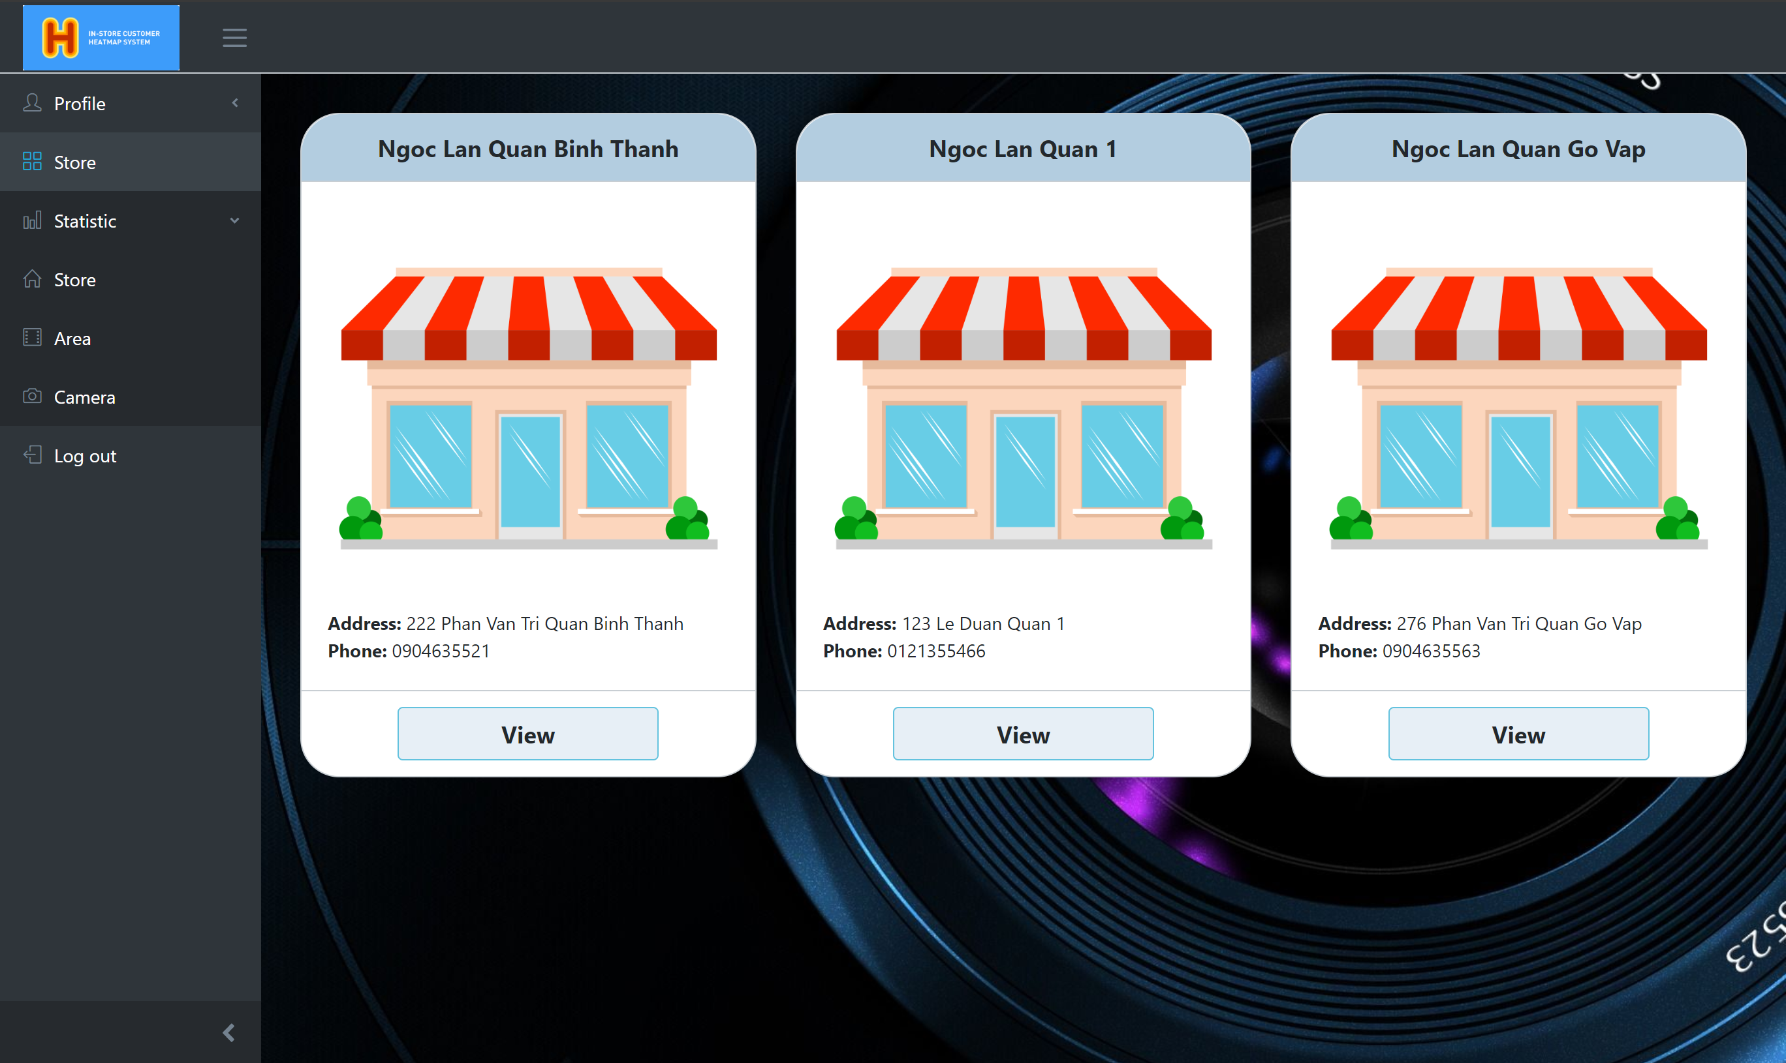
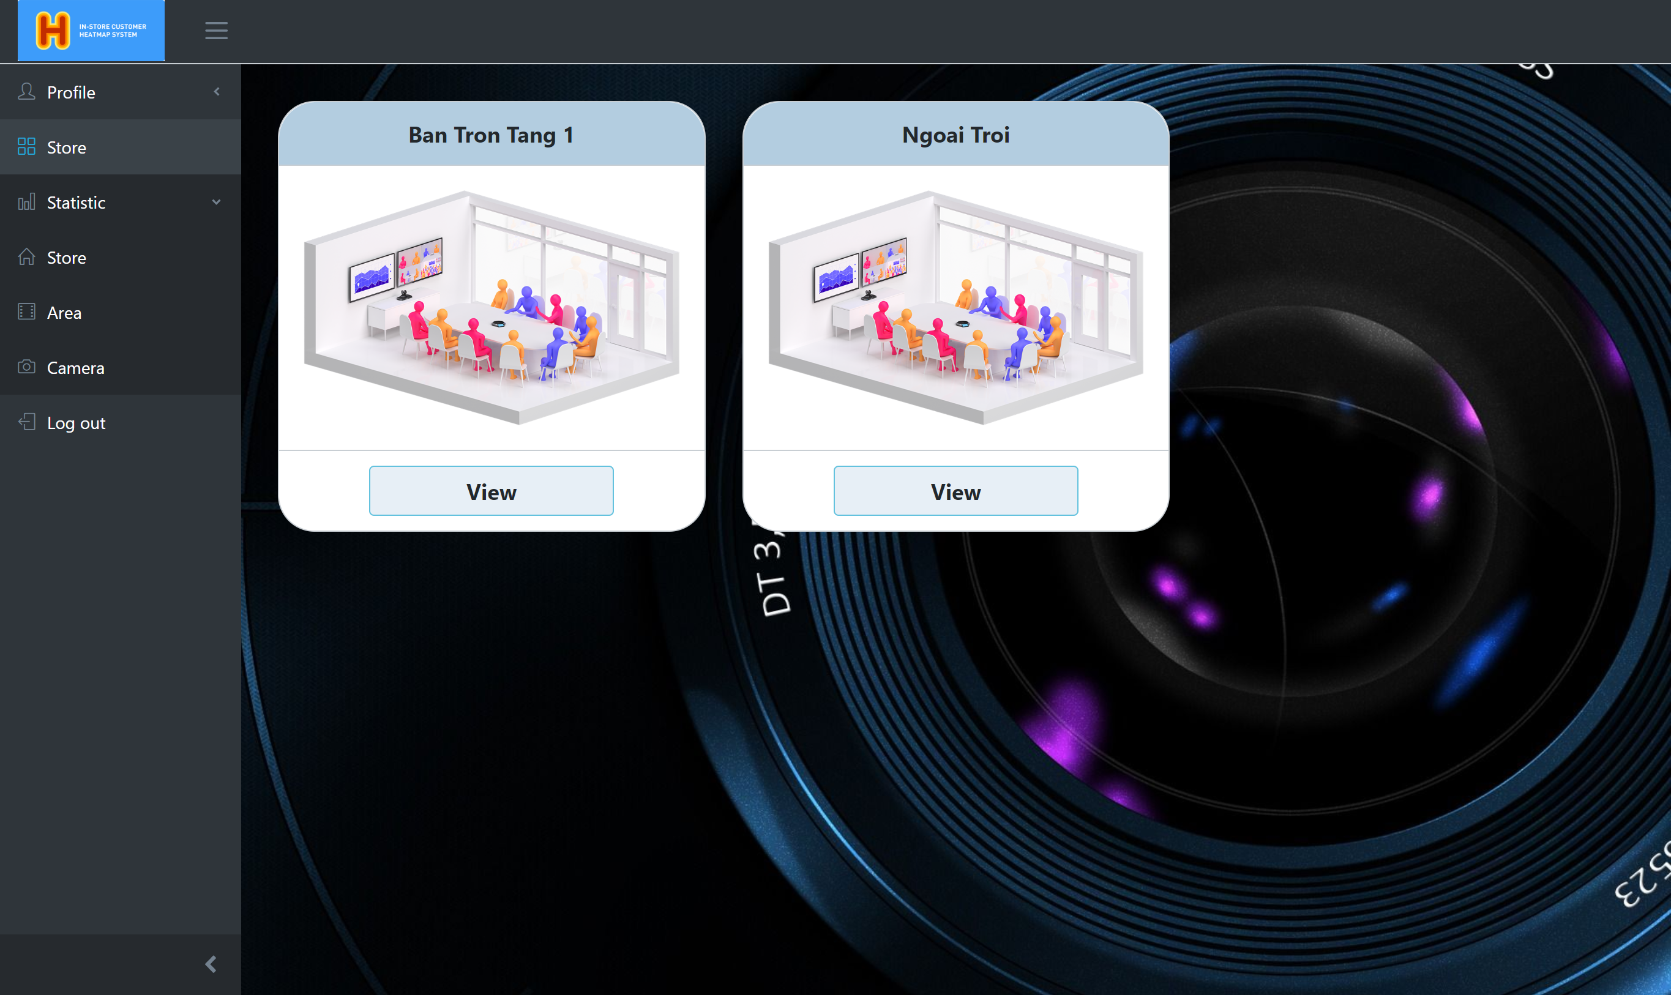
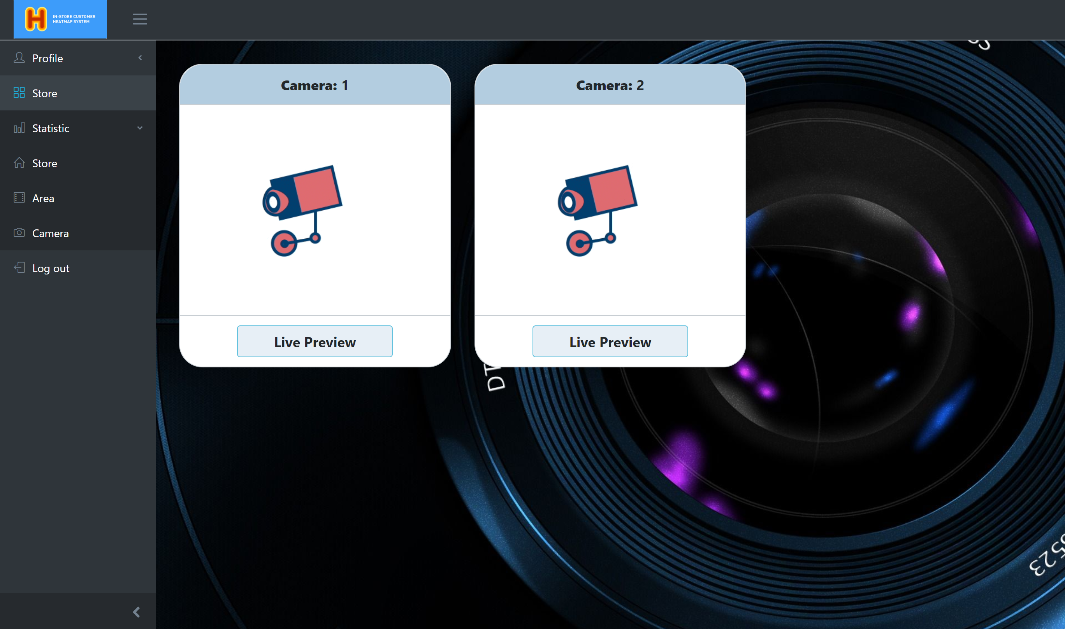
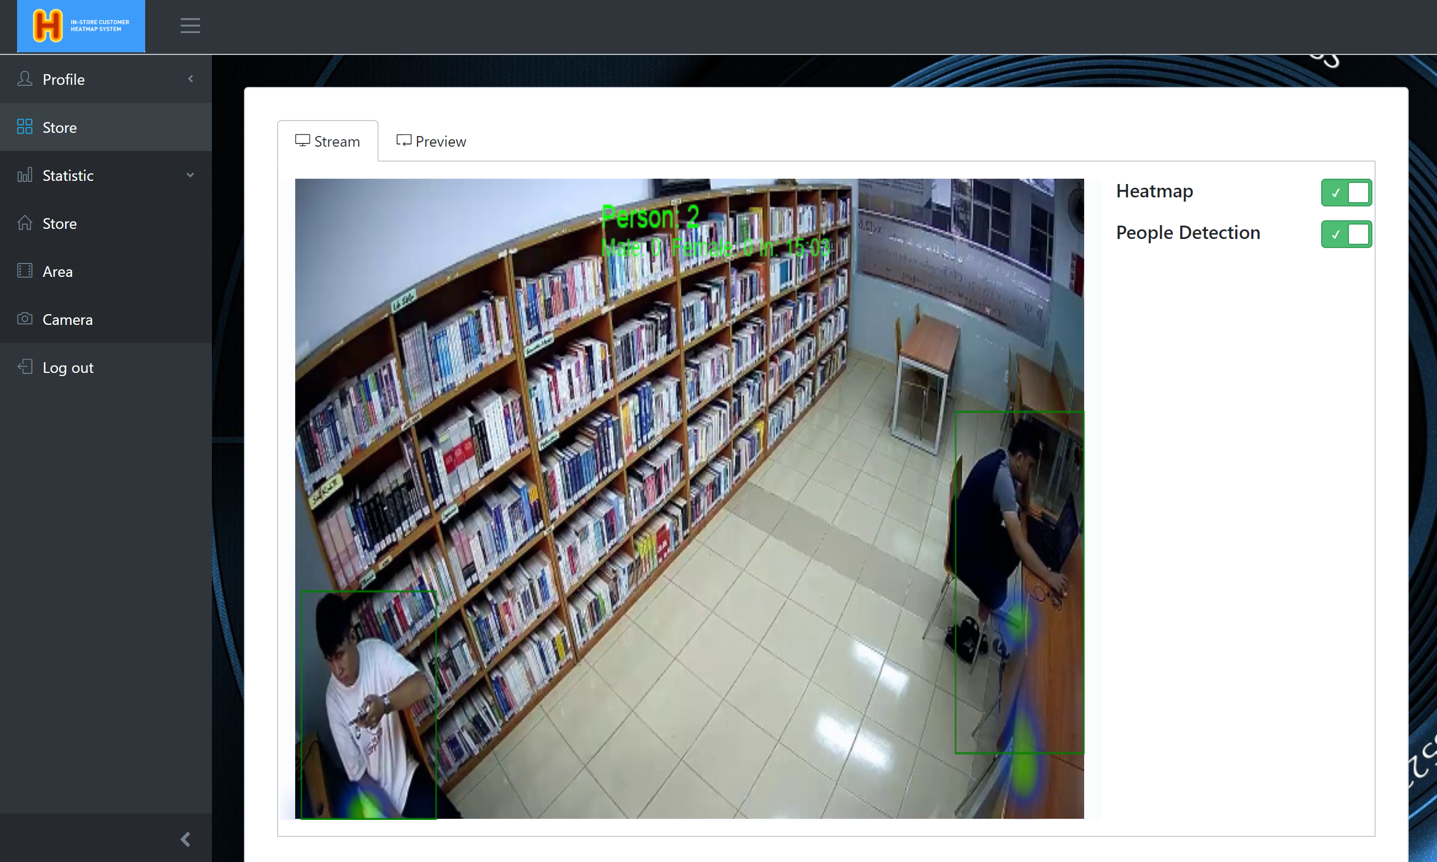
View heatmap & person detection
2. Click on “View” button in store page
1. Login into system with user‘s role
User
3. Click on “View” button in area page
4. Click on “Live Preview” button in camera page
5. Click on “heatmap” and “People detection” button

Slide 4
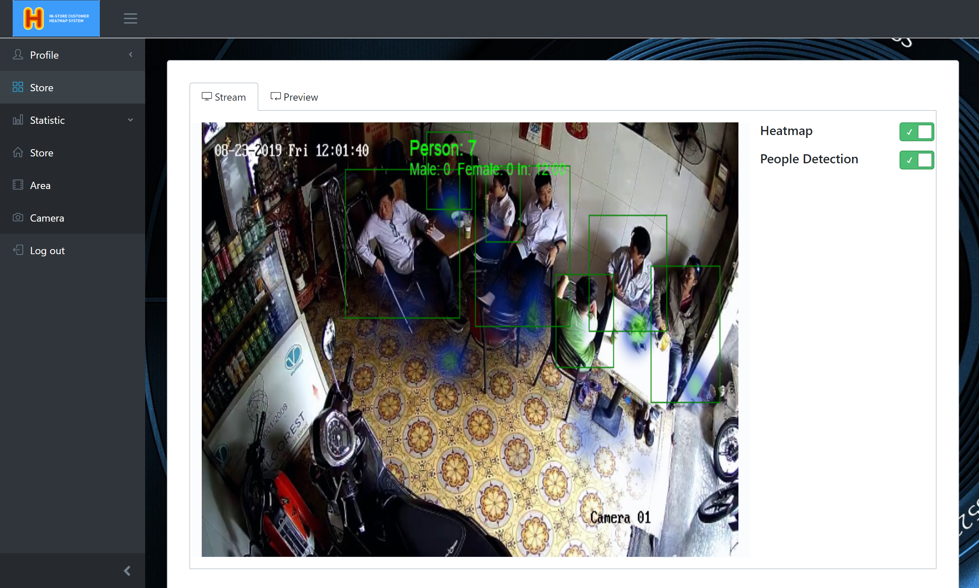
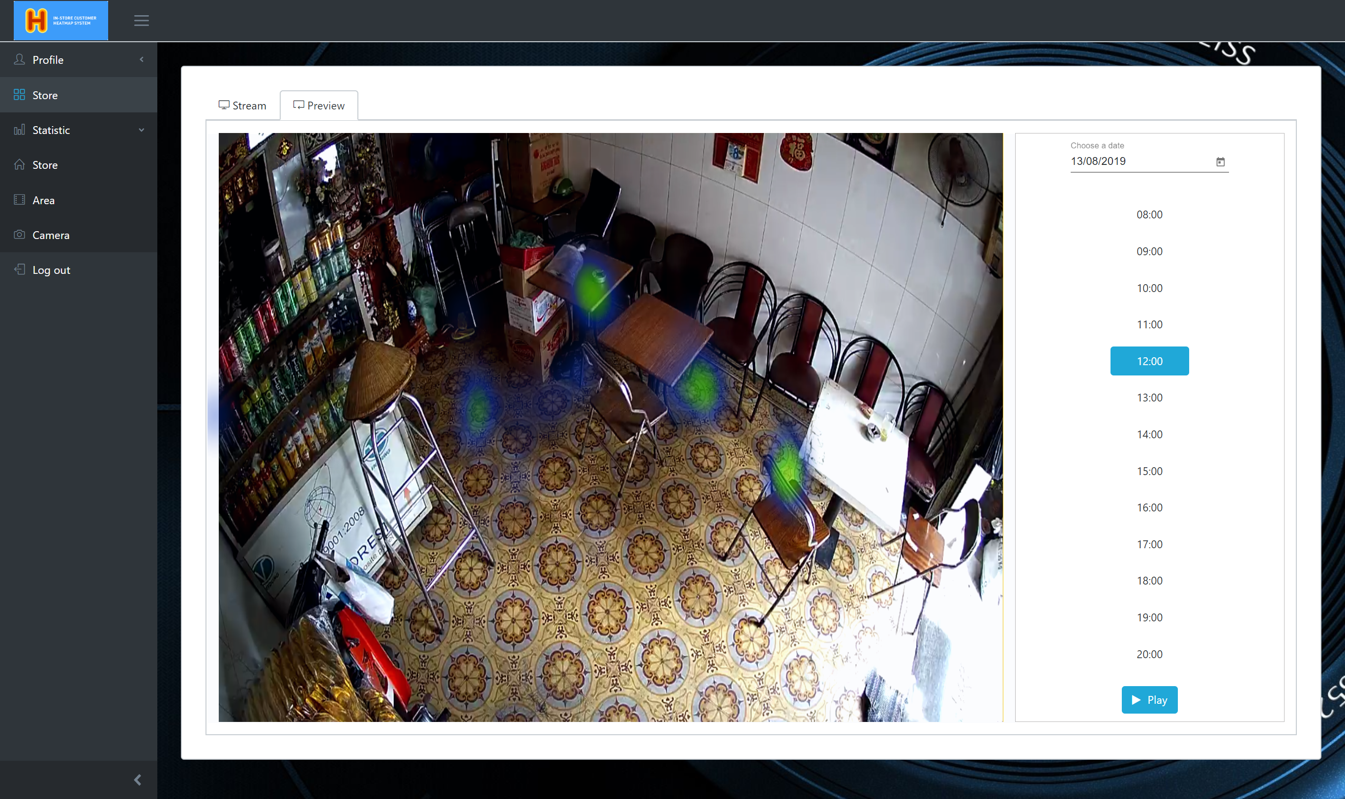
View Preview heatmap
2. Click on “View” button in store page
1. Login into system with user‘s role
User
3. Click on “View” button in area page
4. Click on “Live Preview” button in camera page
5. Click on “Preview” button
6. Click choice time

Slide 5
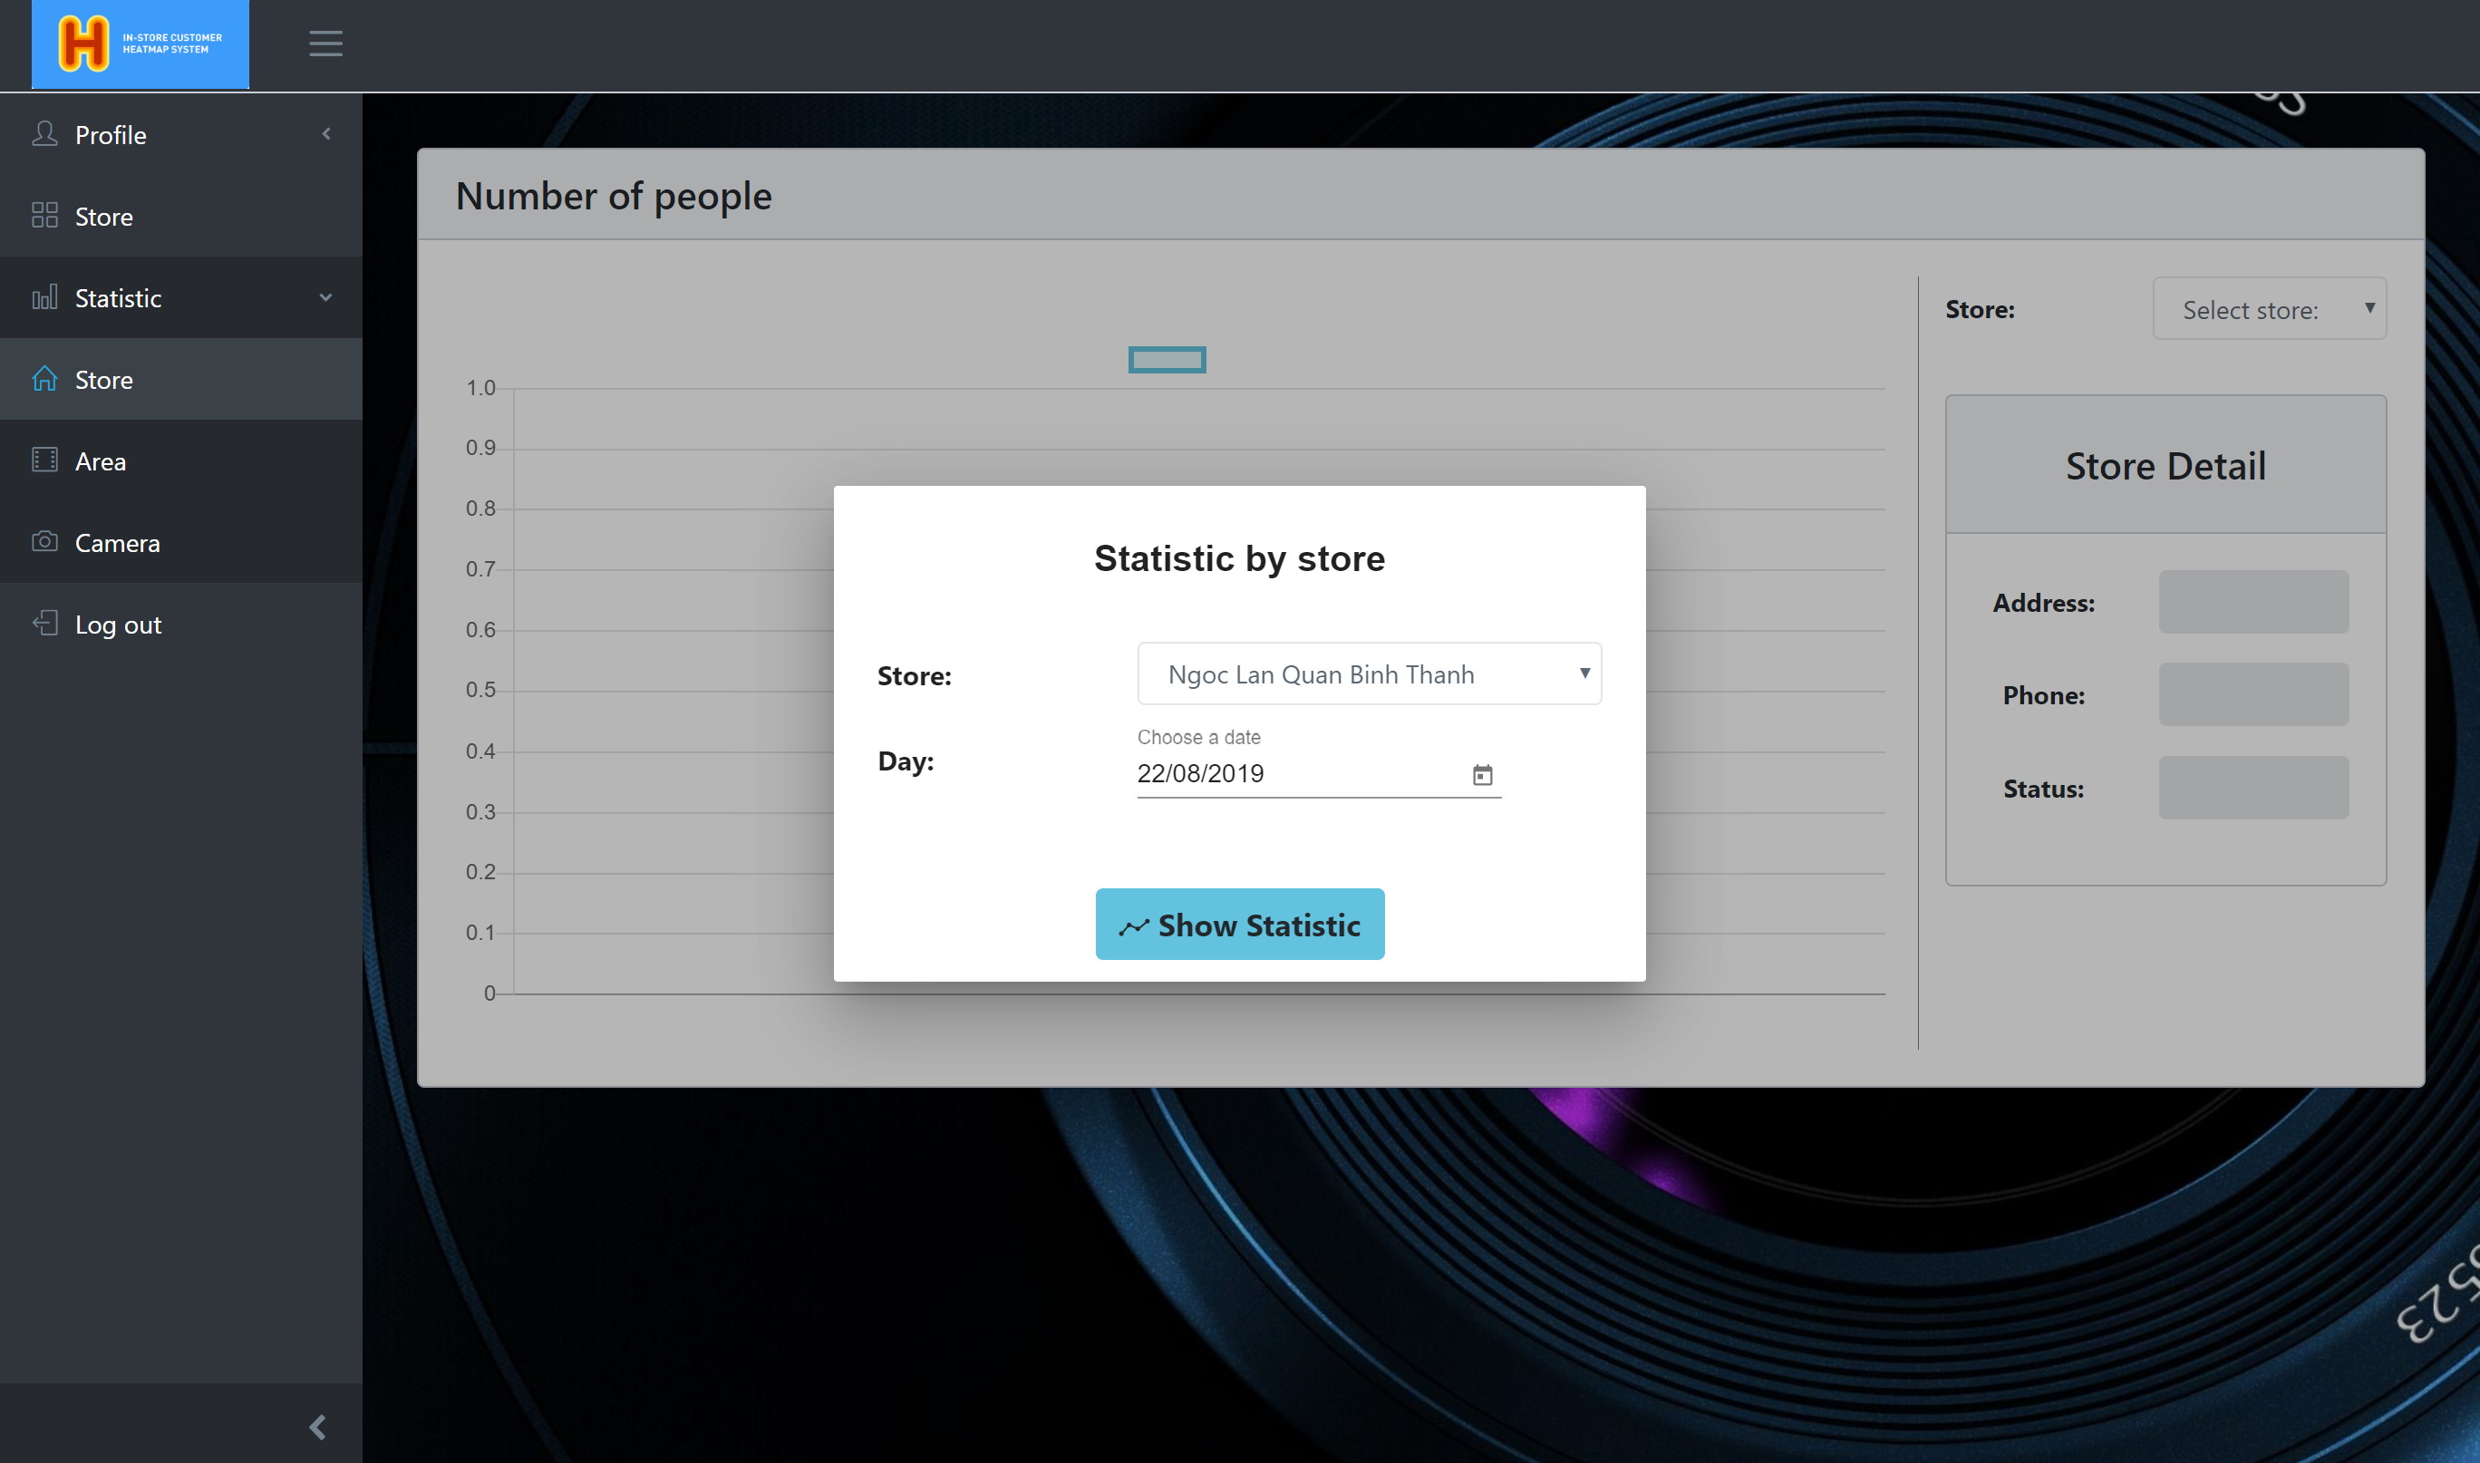
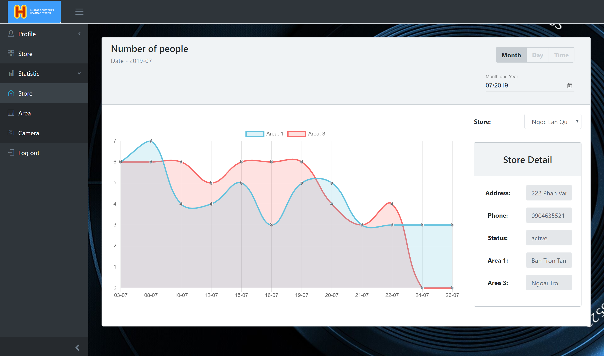
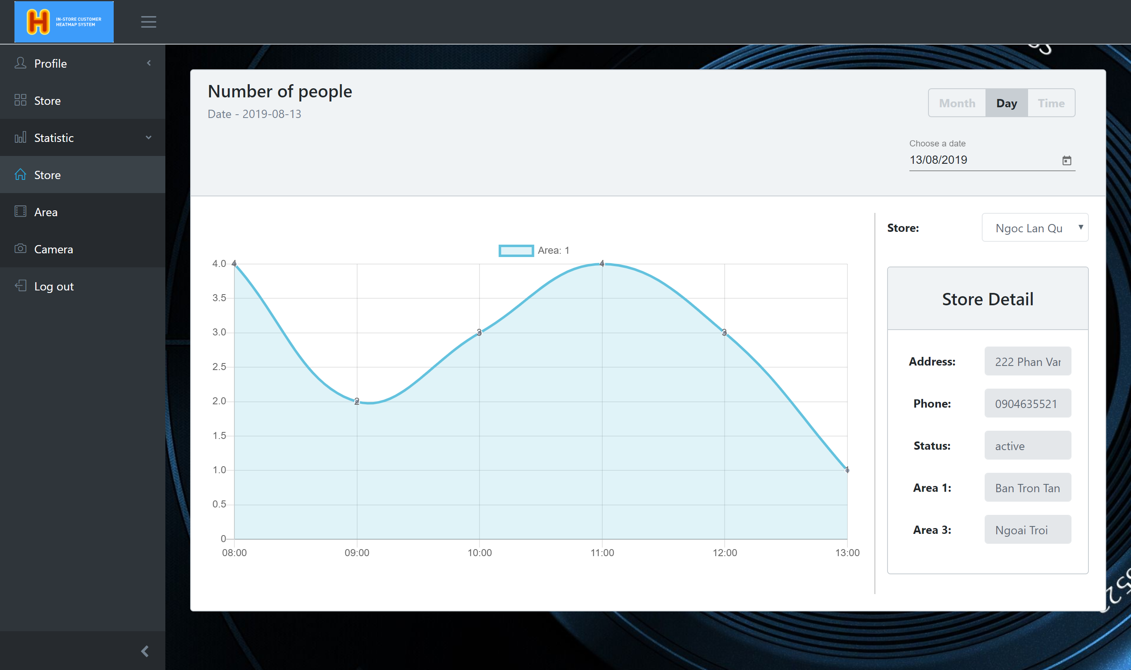
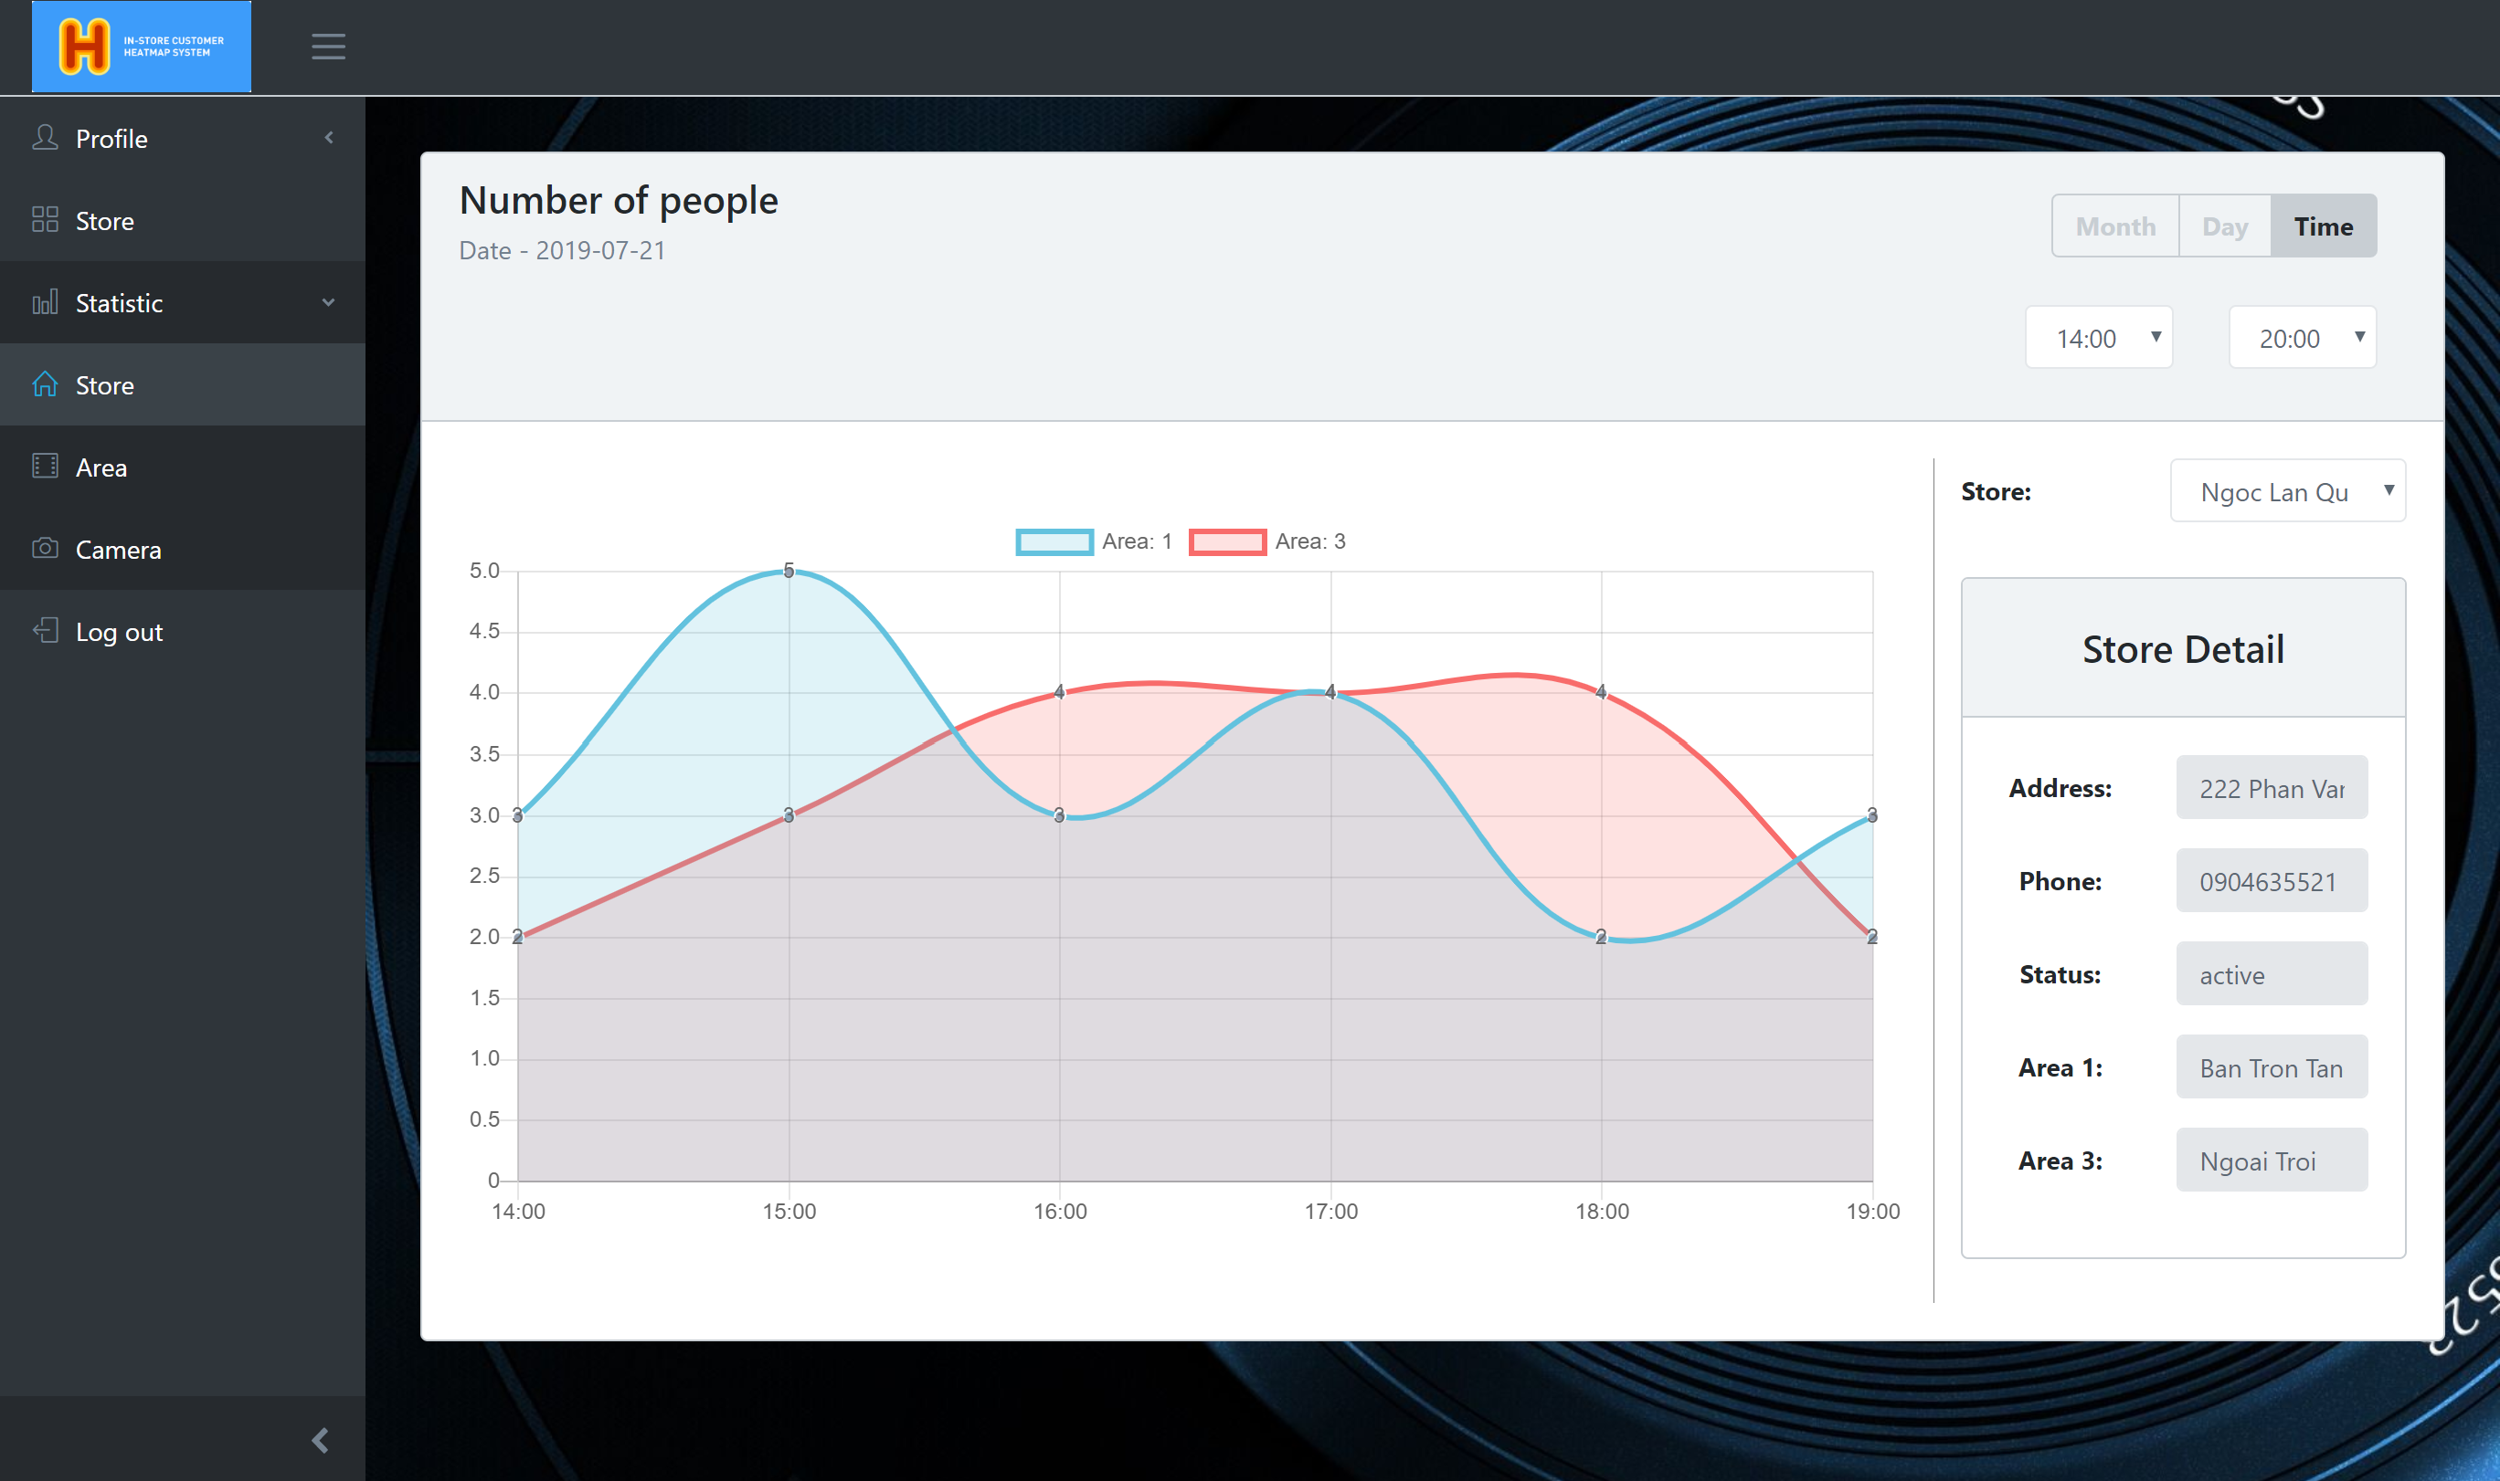
View statistic by store
3. Click on “Show statistic” button
1. Login into system with user‘s role
2. Choice store and date
User
4.1 Click on “Month” button.
4.2 Click on “Time” button.

Slide 6
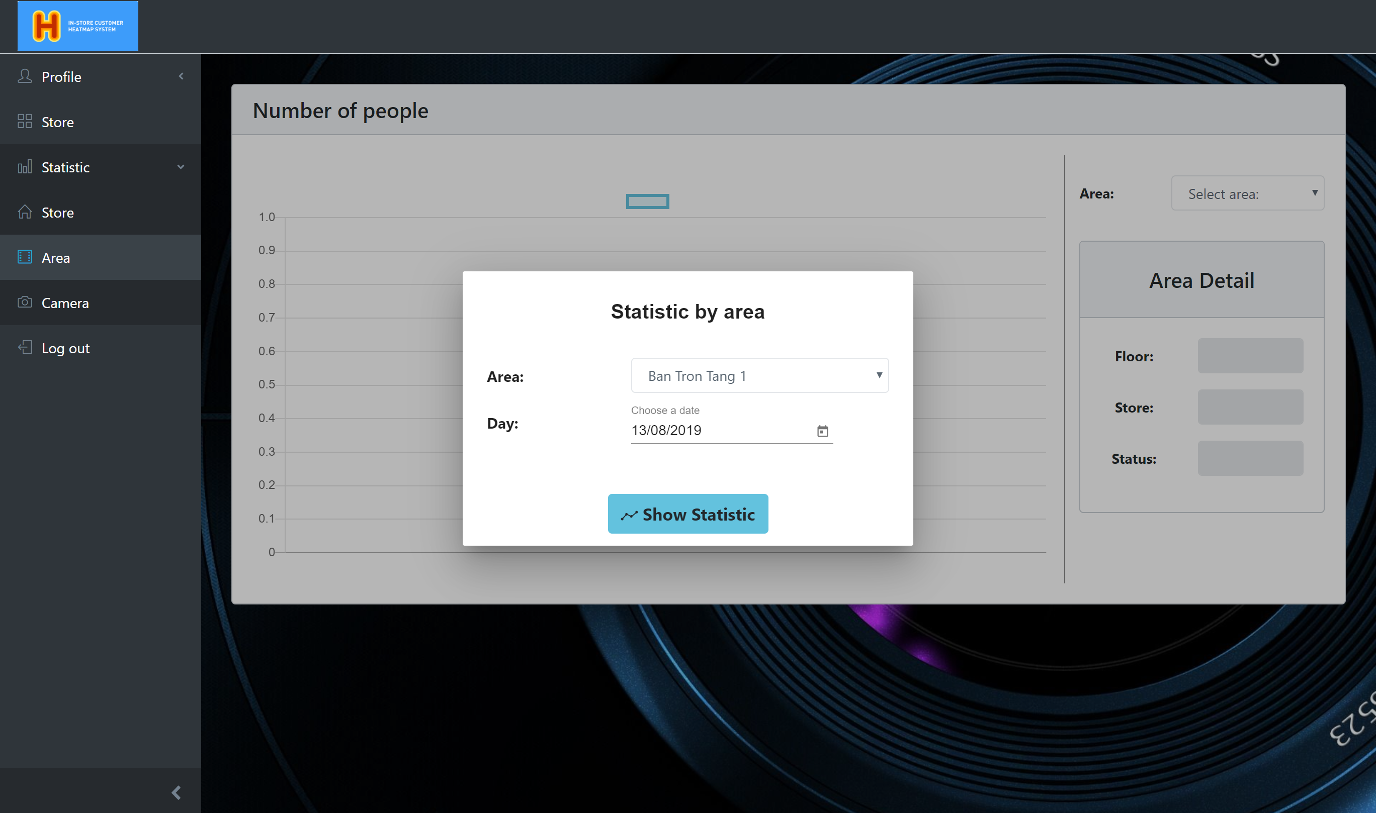
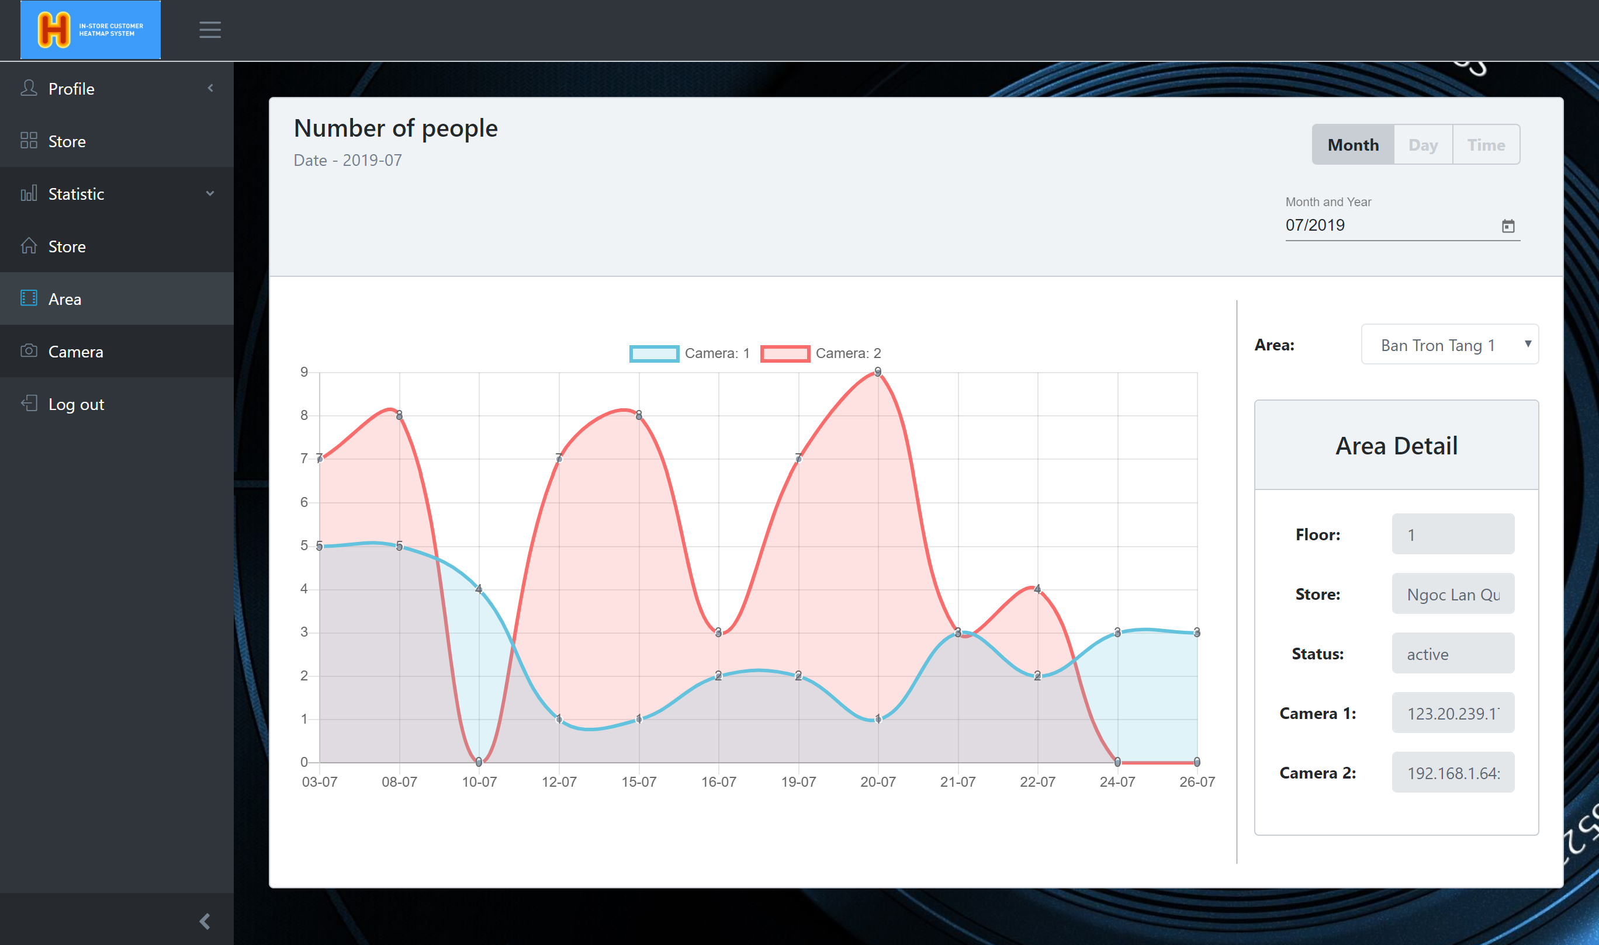
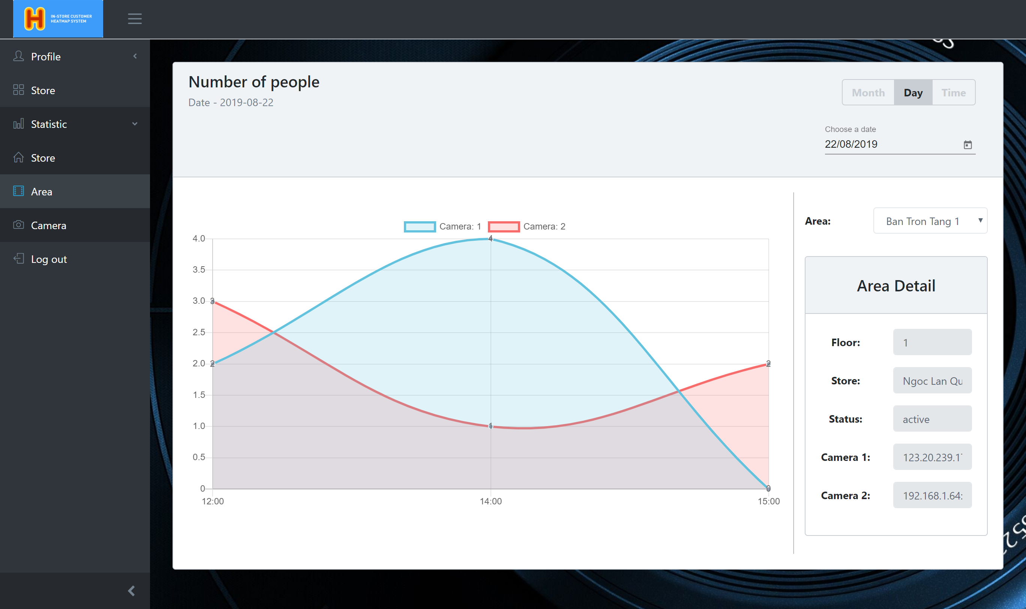
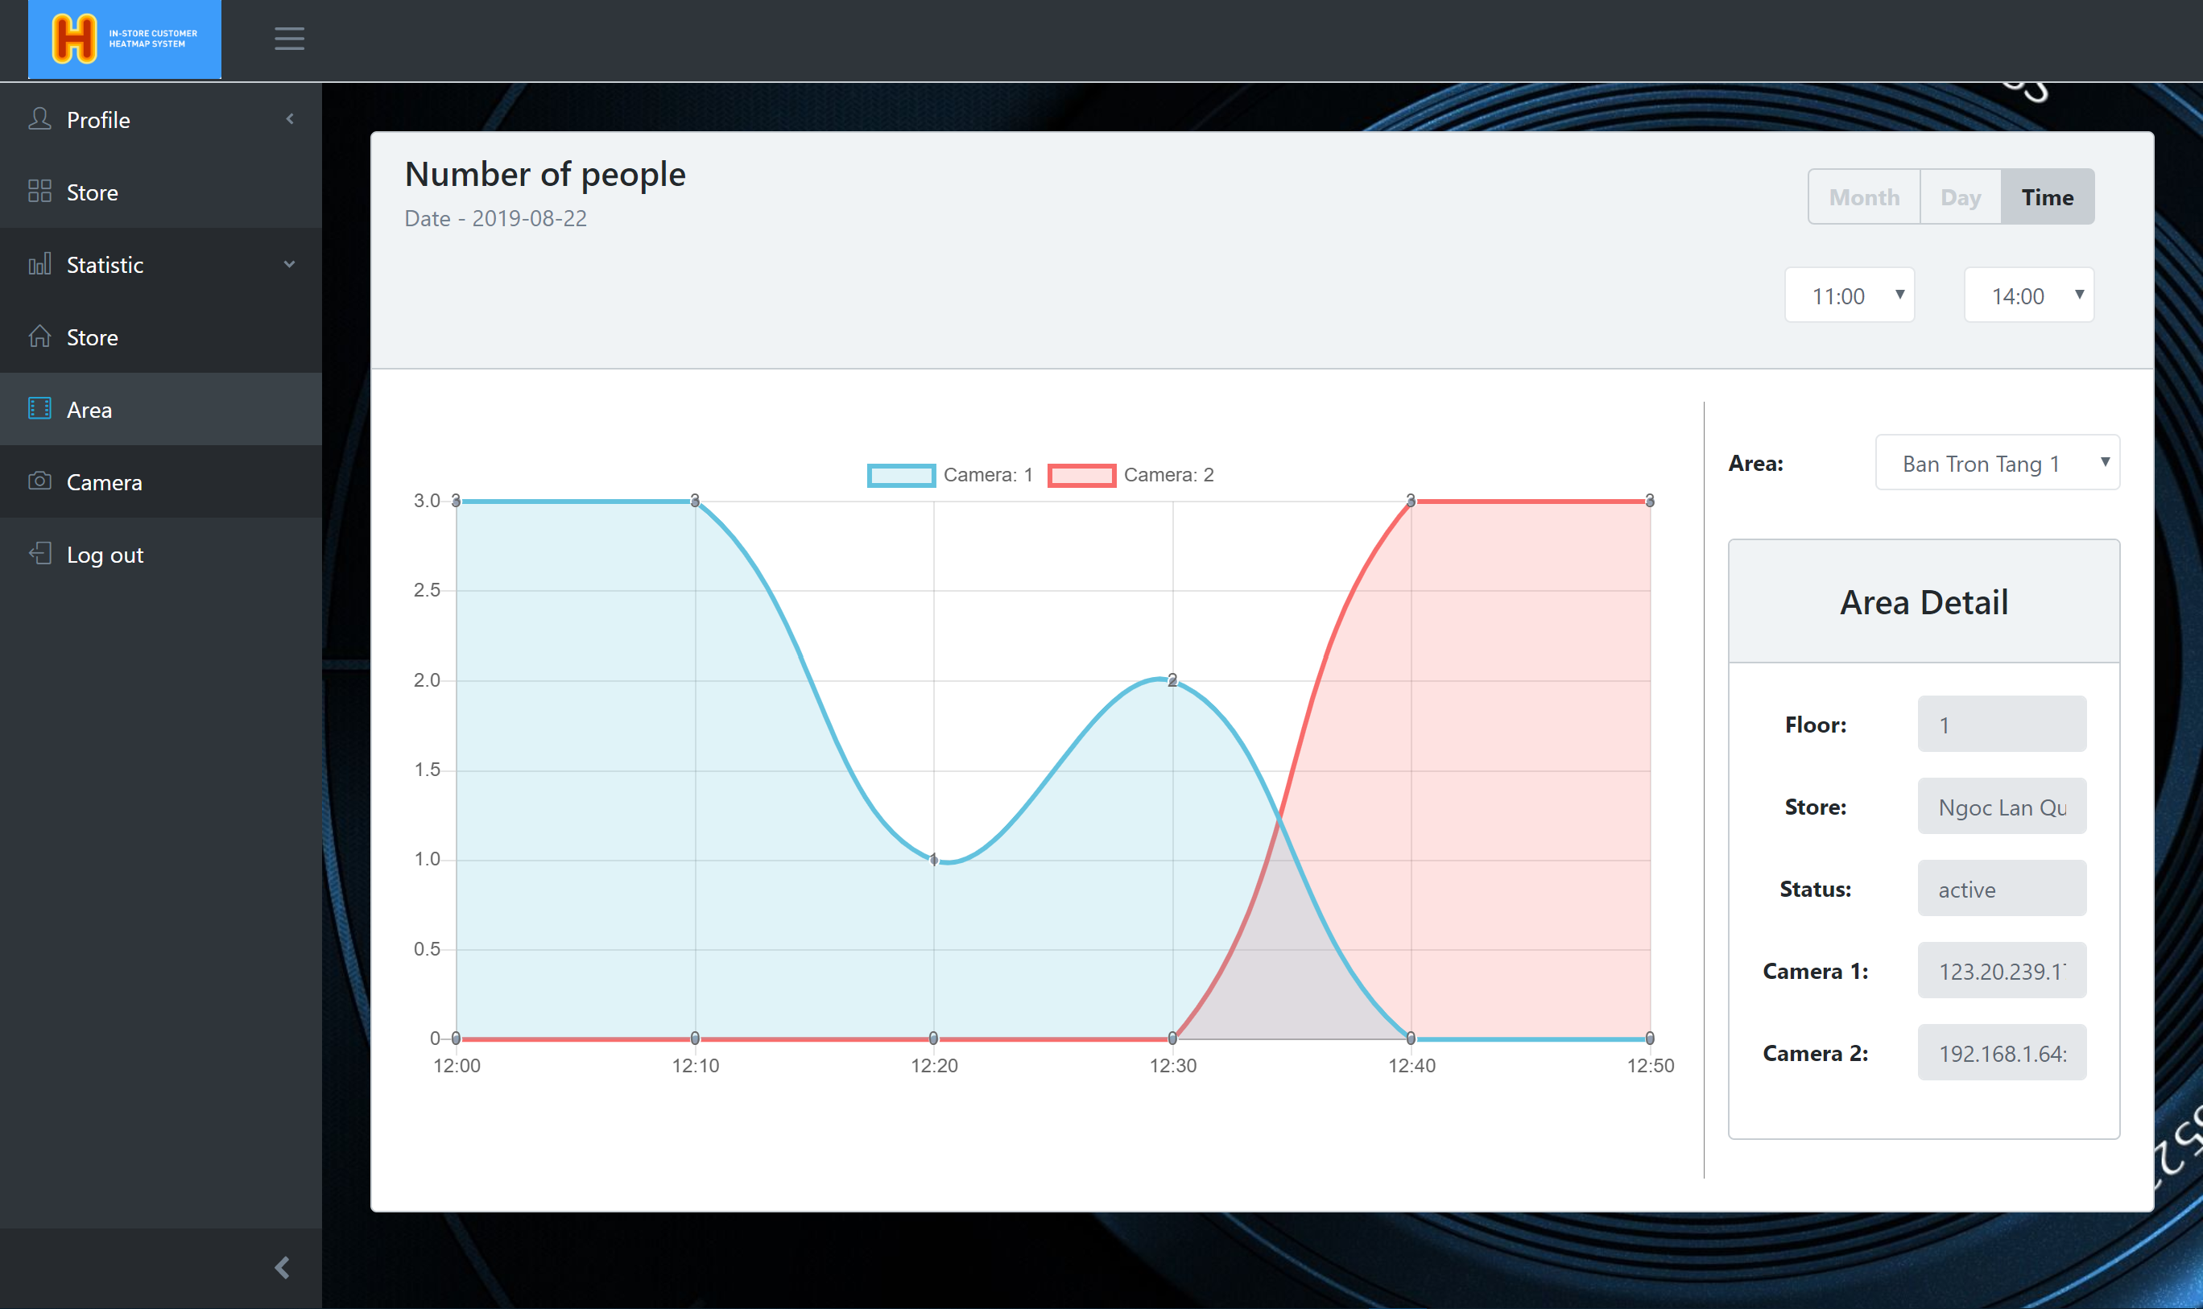
View statistic by area
3. Click on “Show statistic” button
1. Login into system with user‘s role
2. Choice area and date
User
4.1 Click on “Month” button.
4.2 Click on “Time” button.

Slide 7
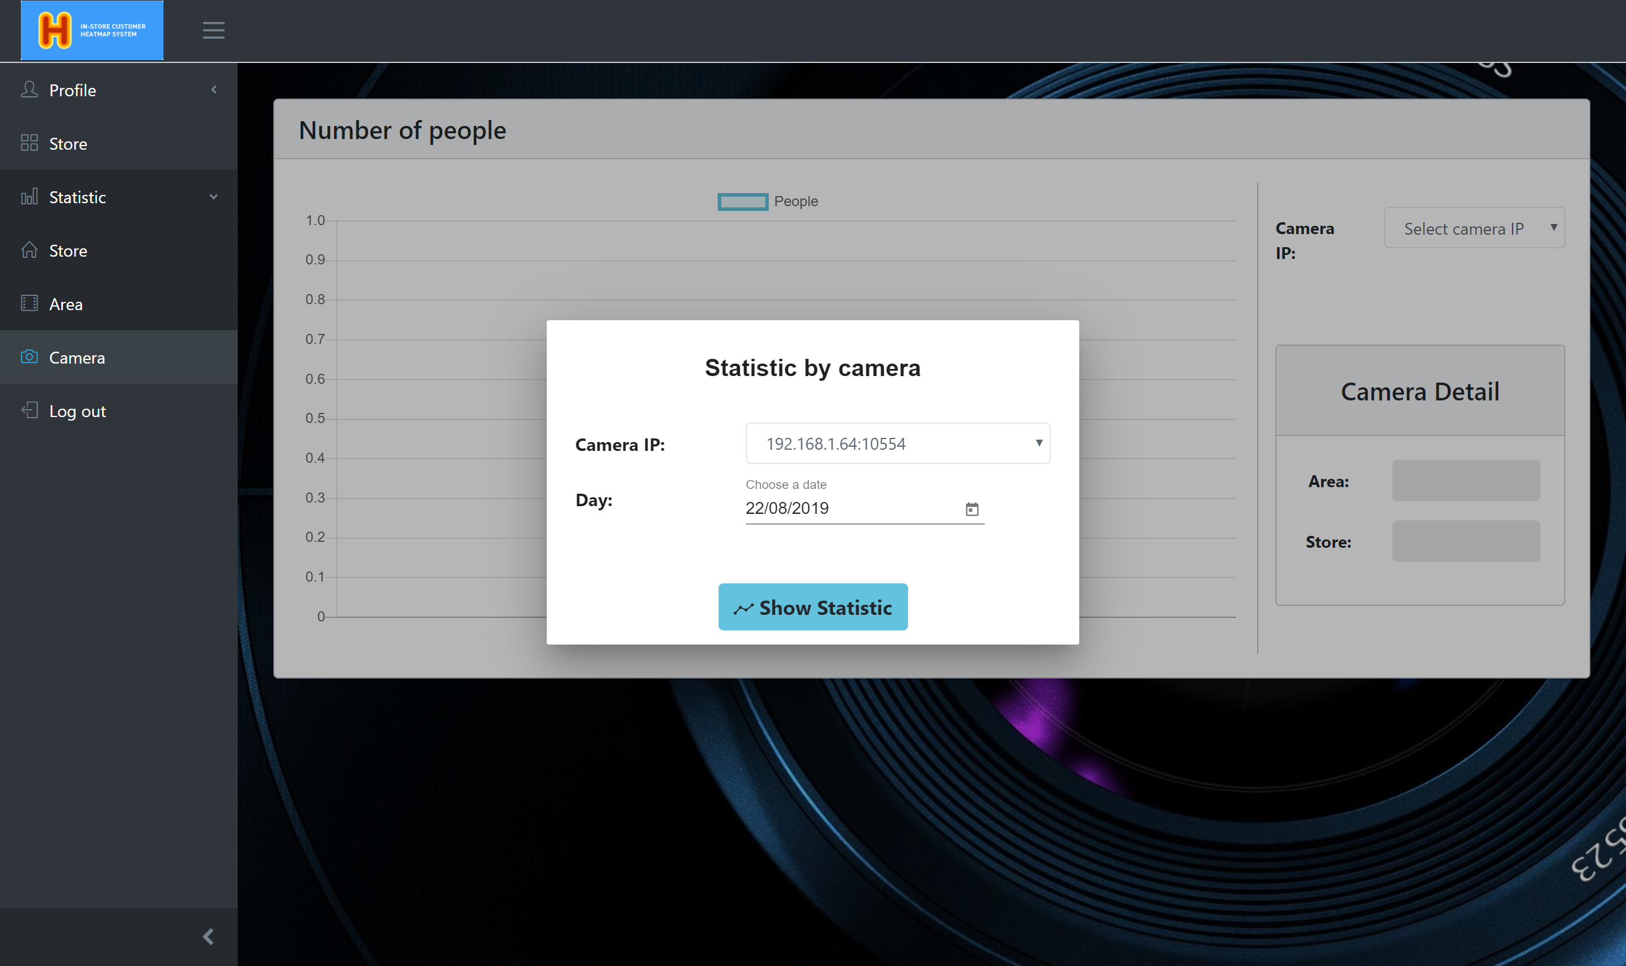
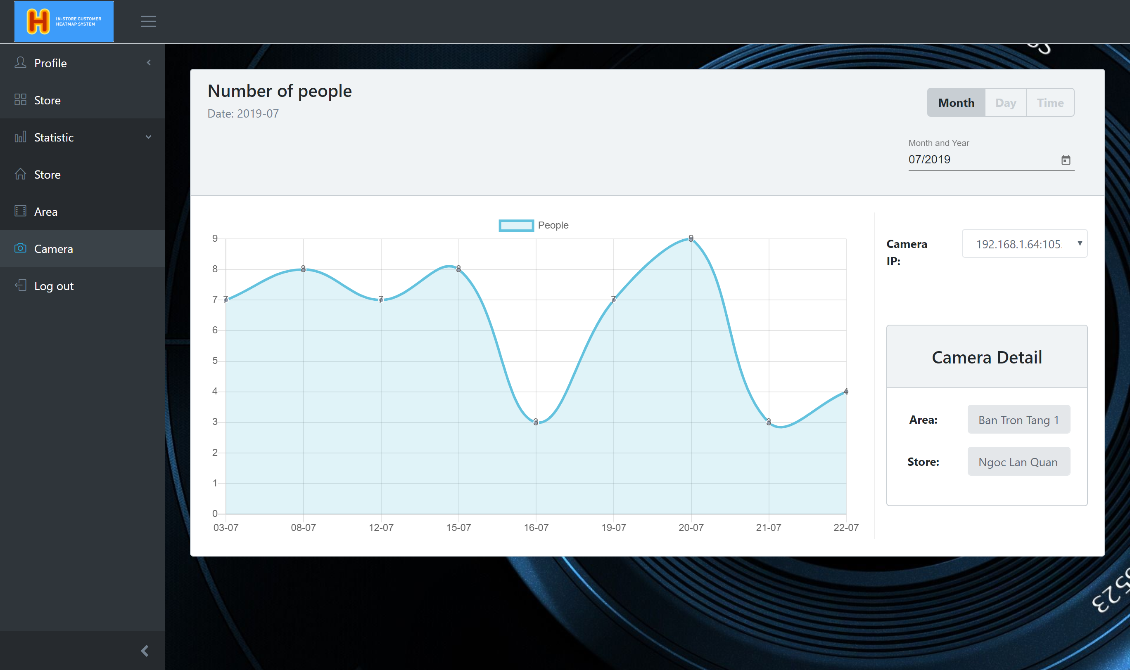
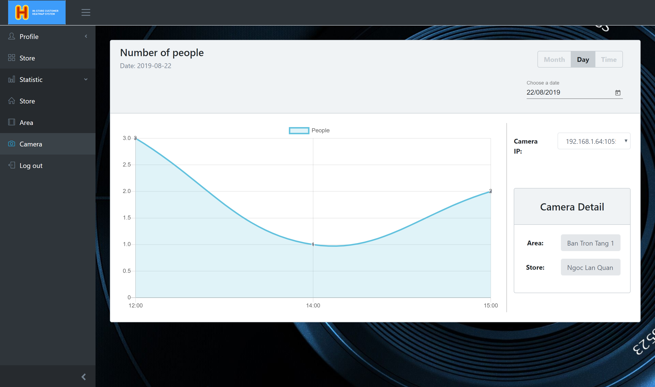
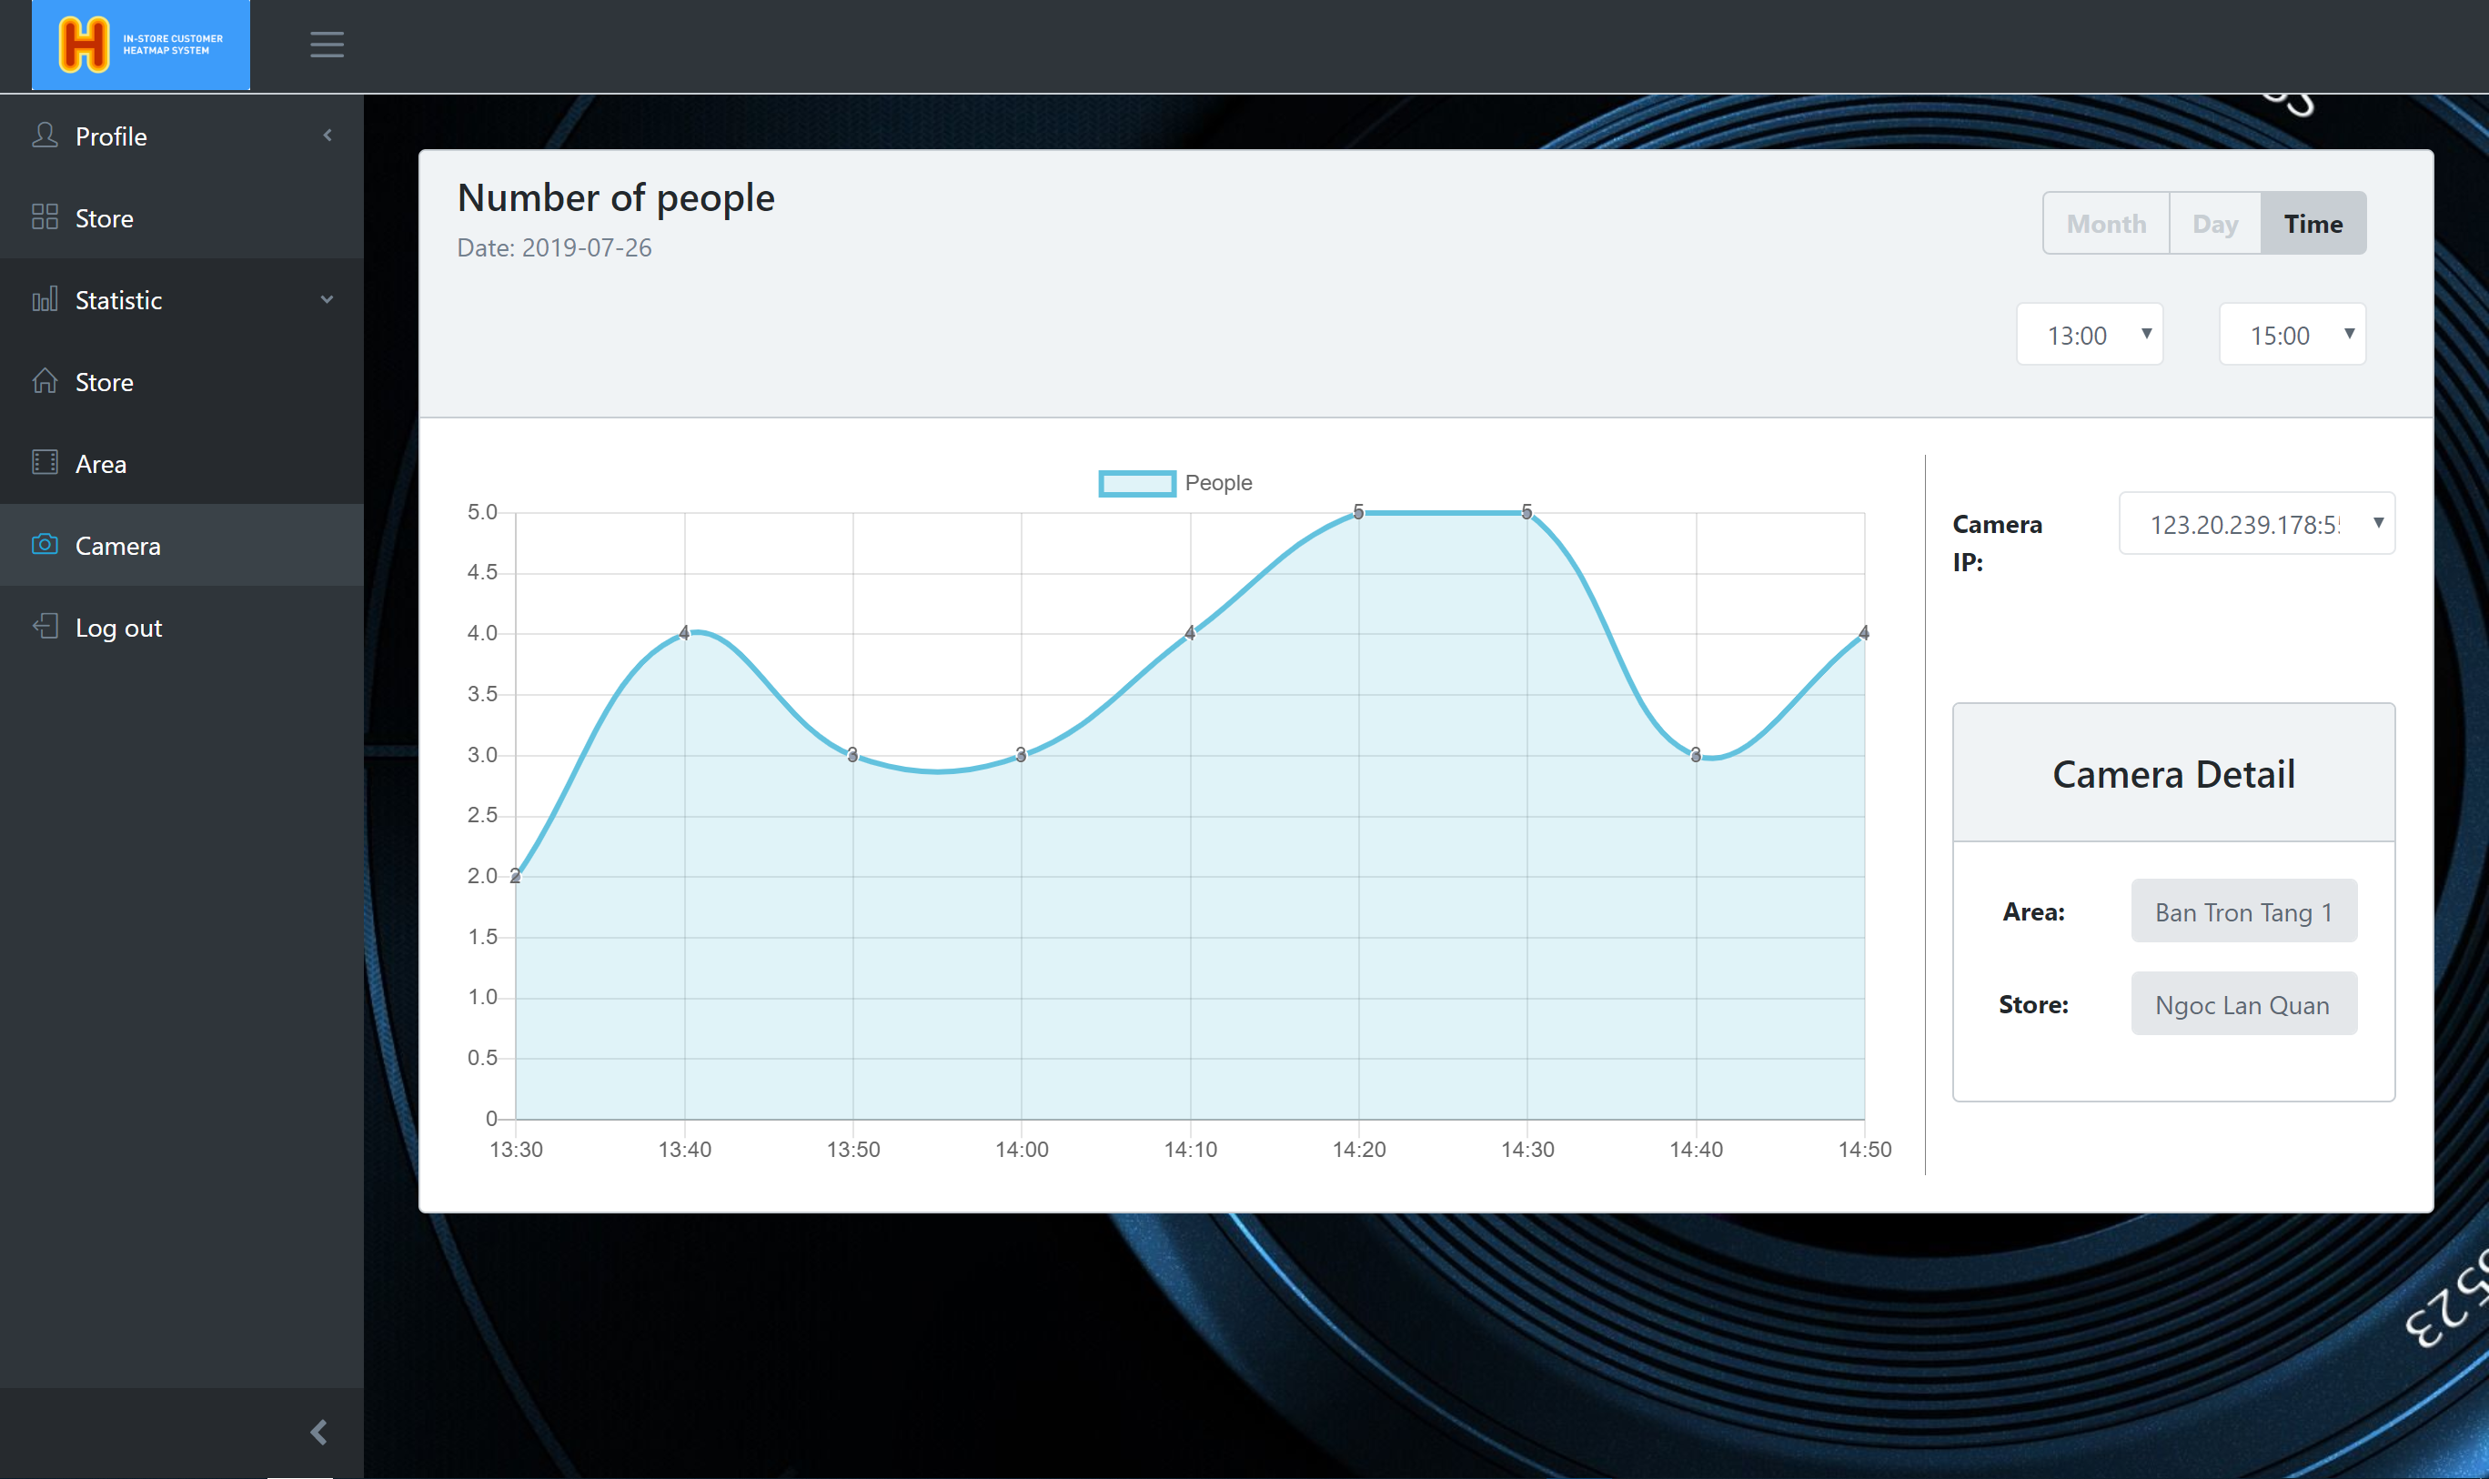
View statistic by camera
3. Click on “Show statistic” button
1. Login into system with user‘s role
2. Choice area and date
User
4.1 Click on “Month” button.
4.2 Click on “Time” button.

Slide 8
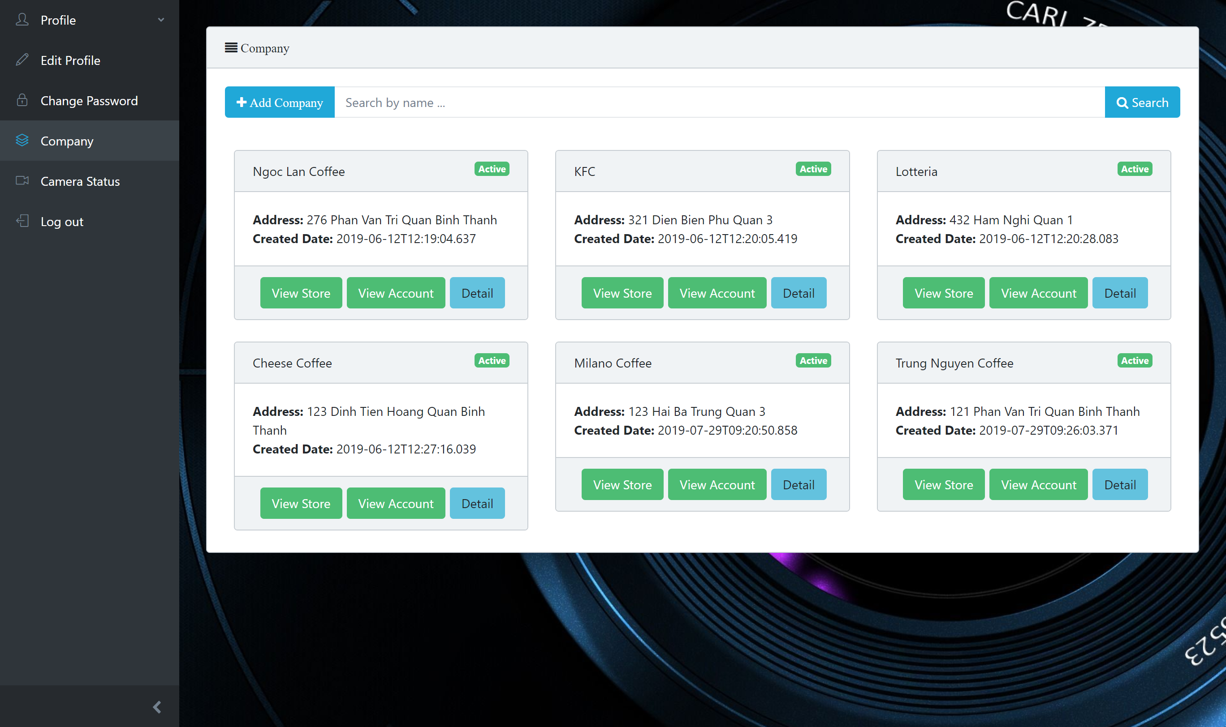
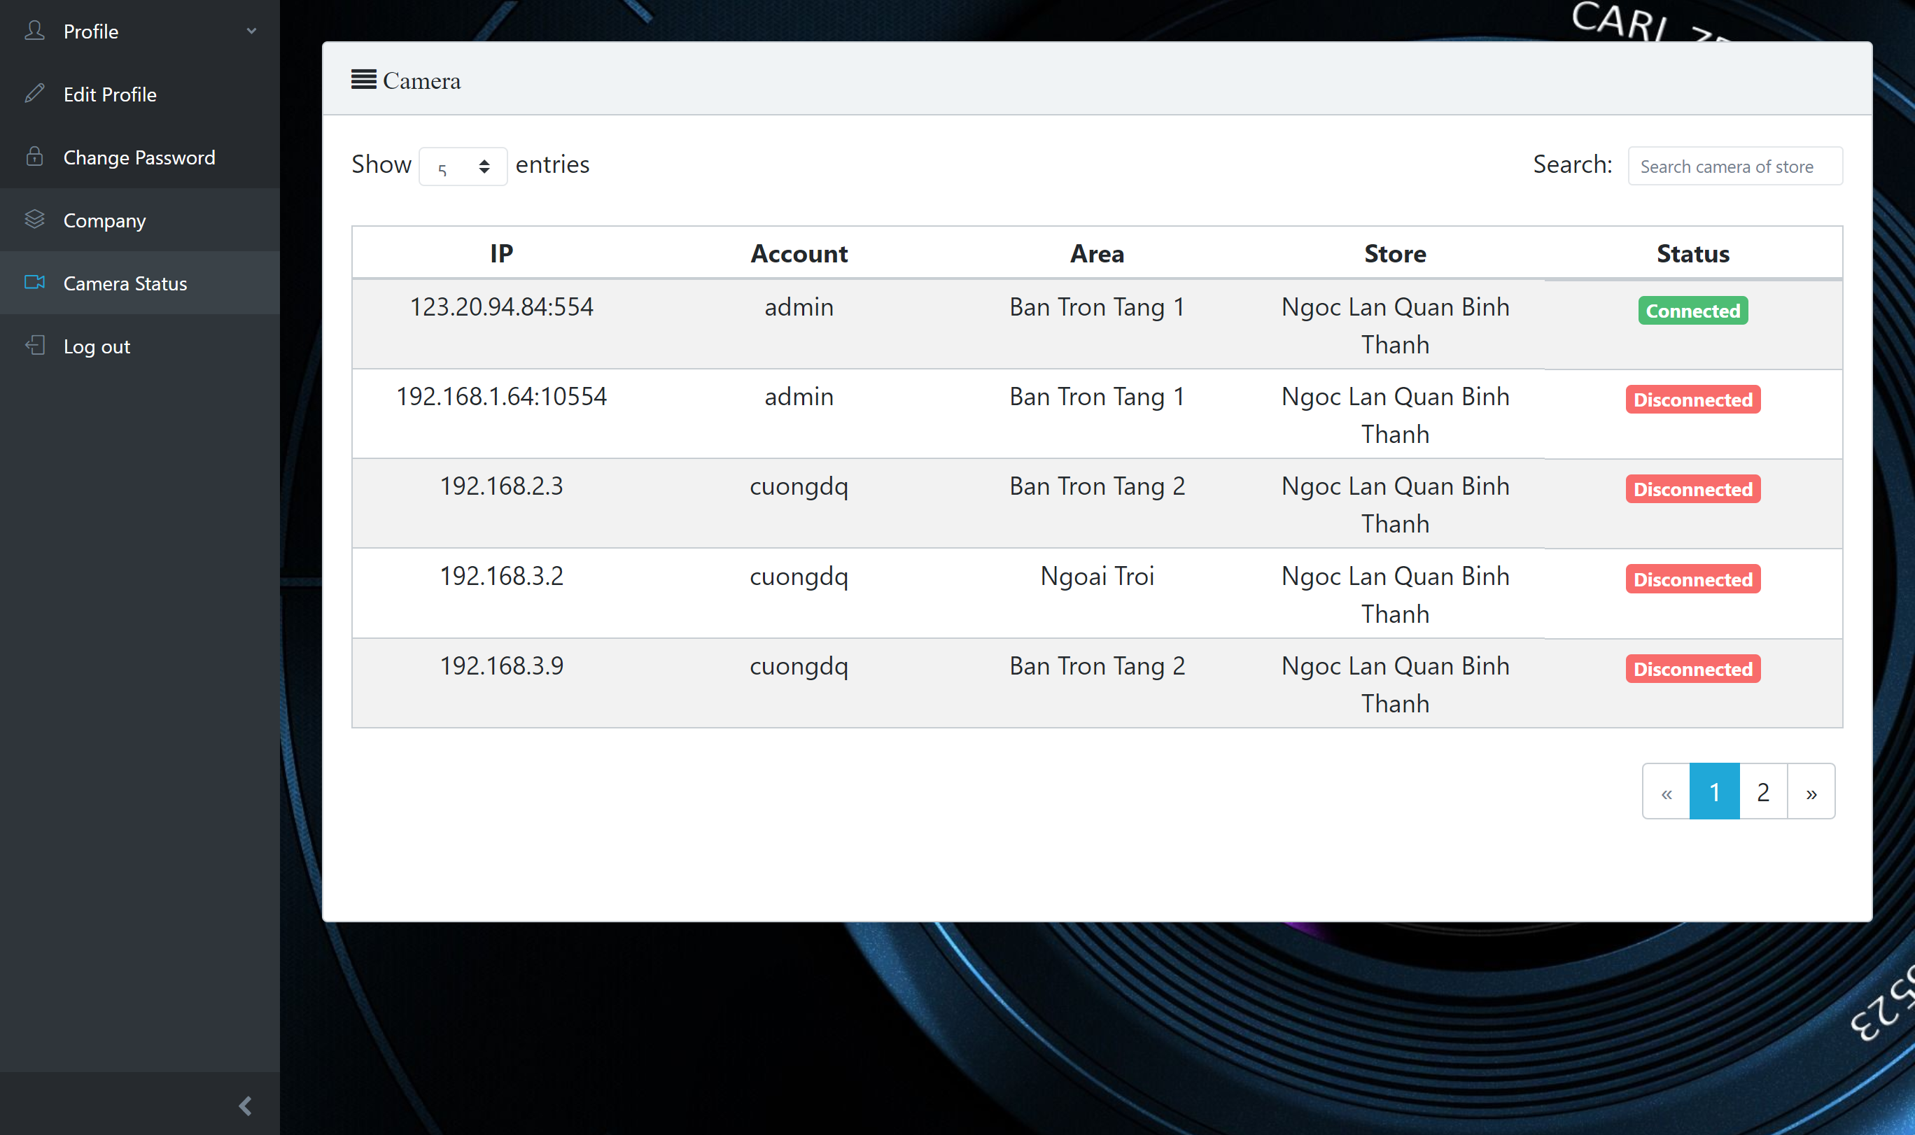
View status camera
2. Click on “Camera status” button
1. Login into system with admin‘s role
Admin
3. Request camera active and inactive

Slide 9
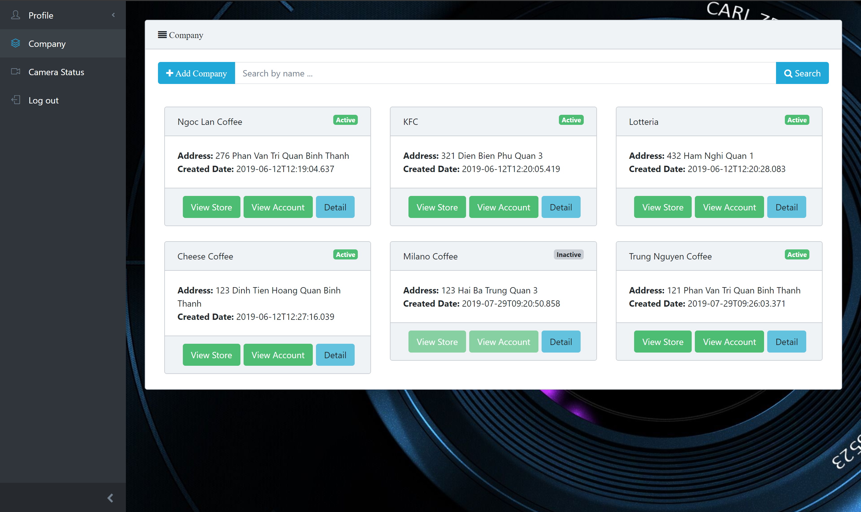
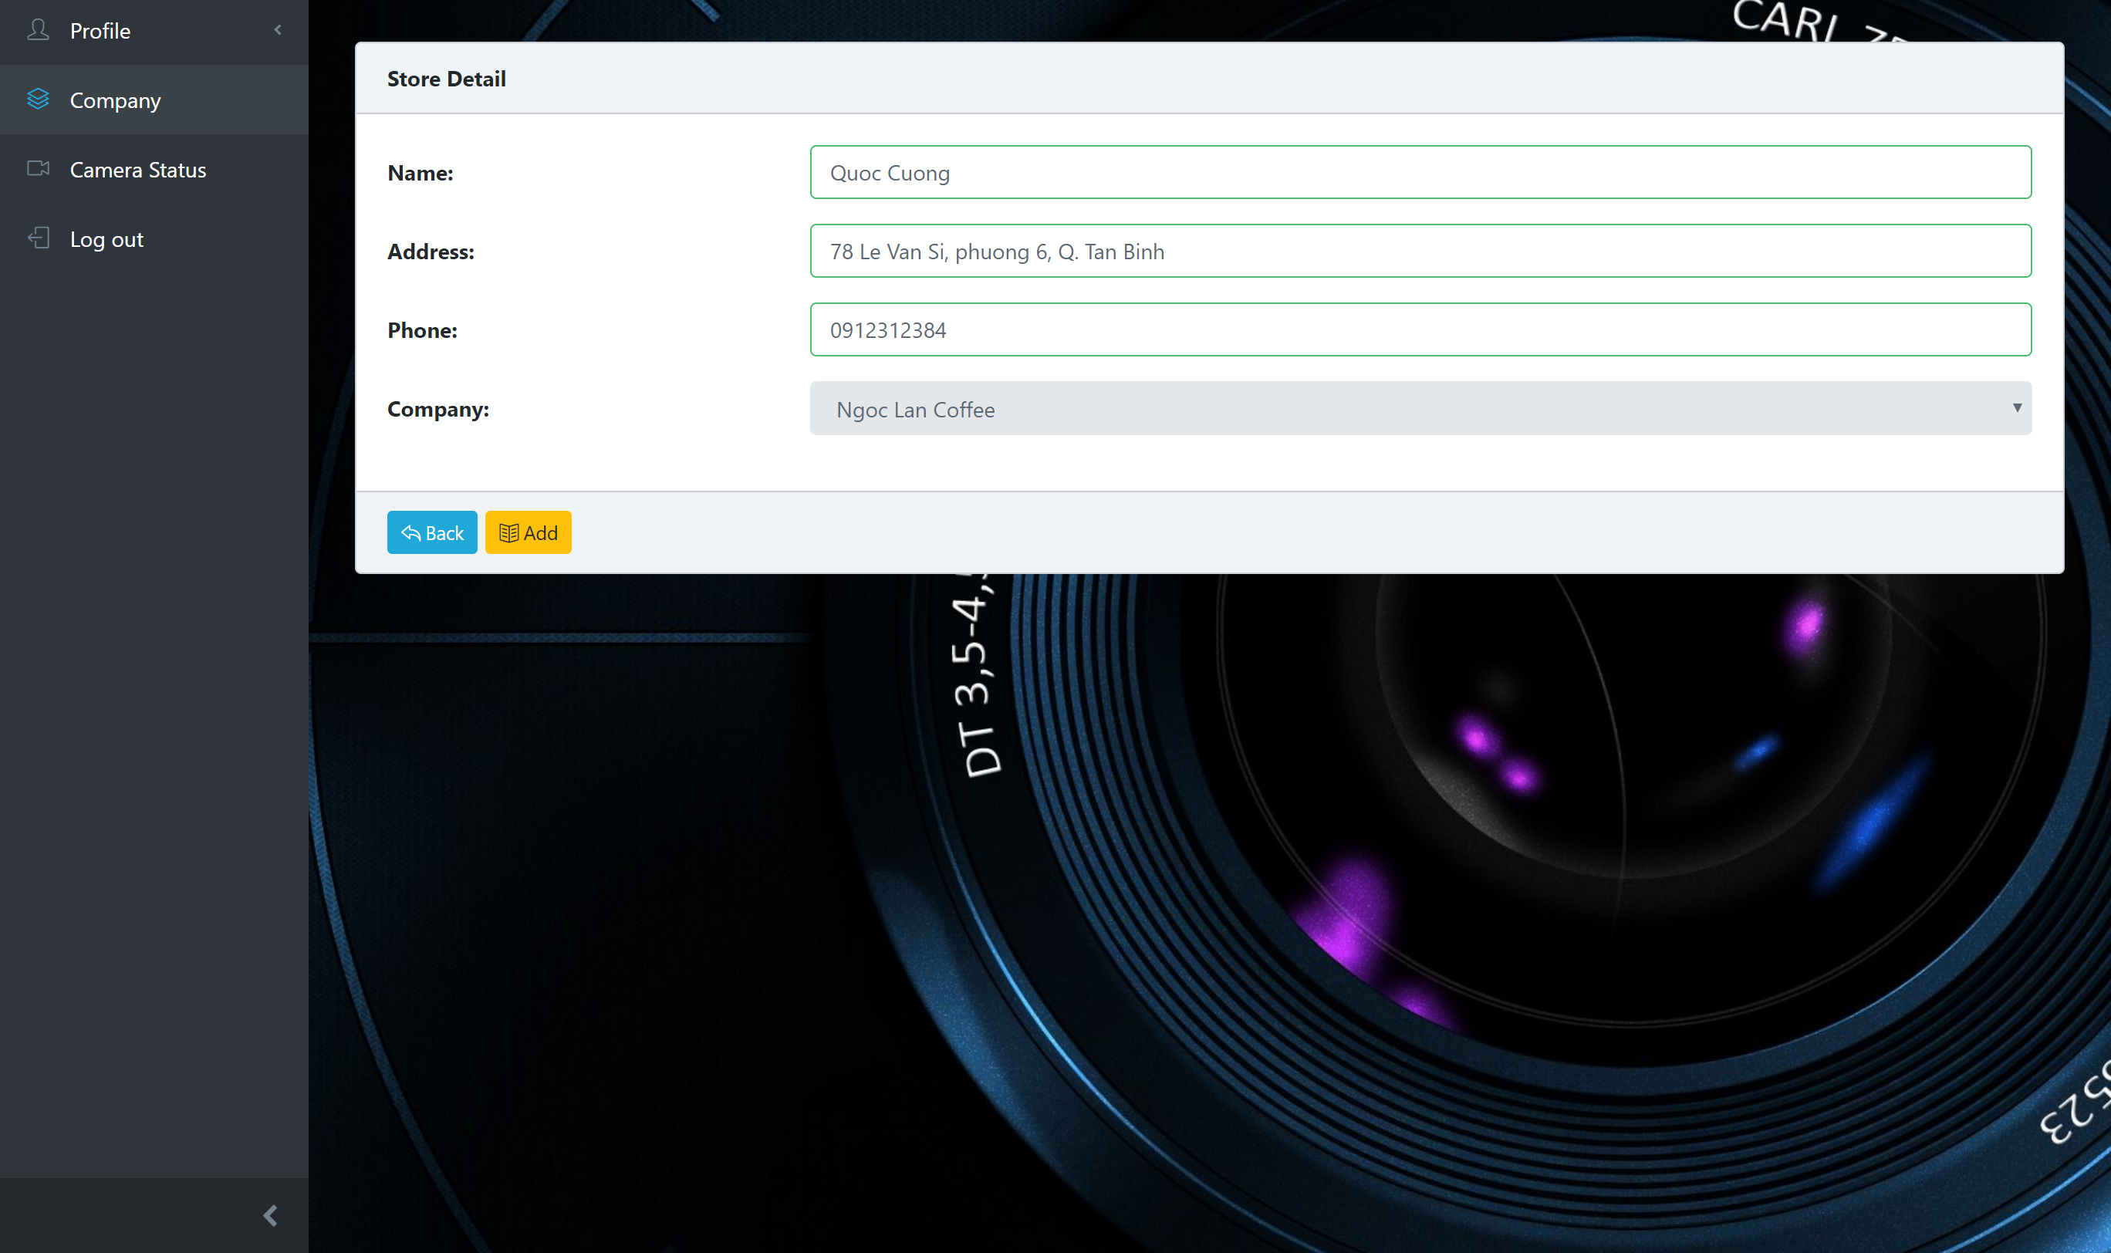
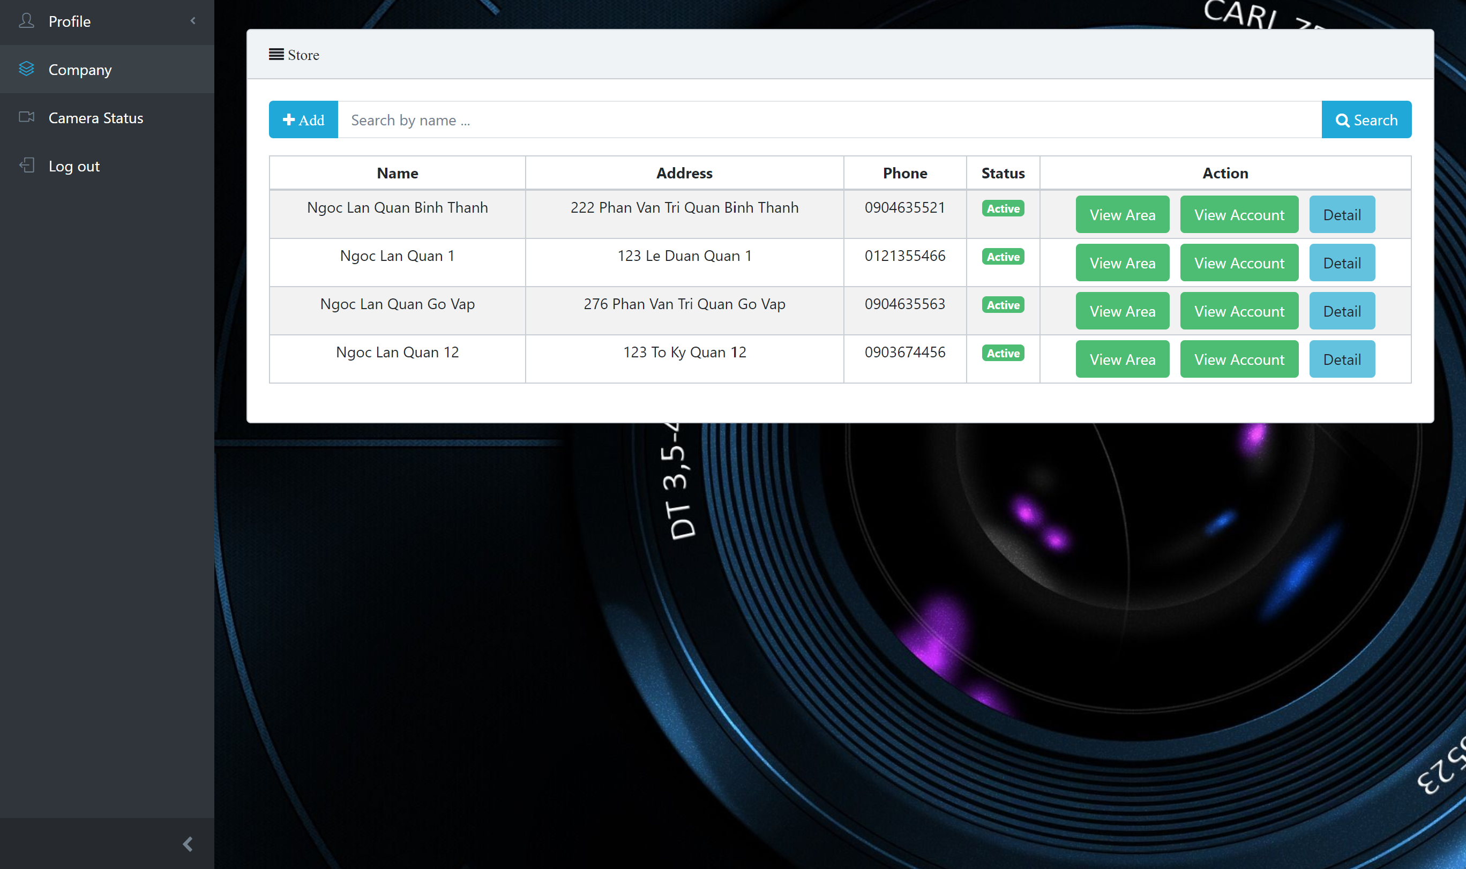
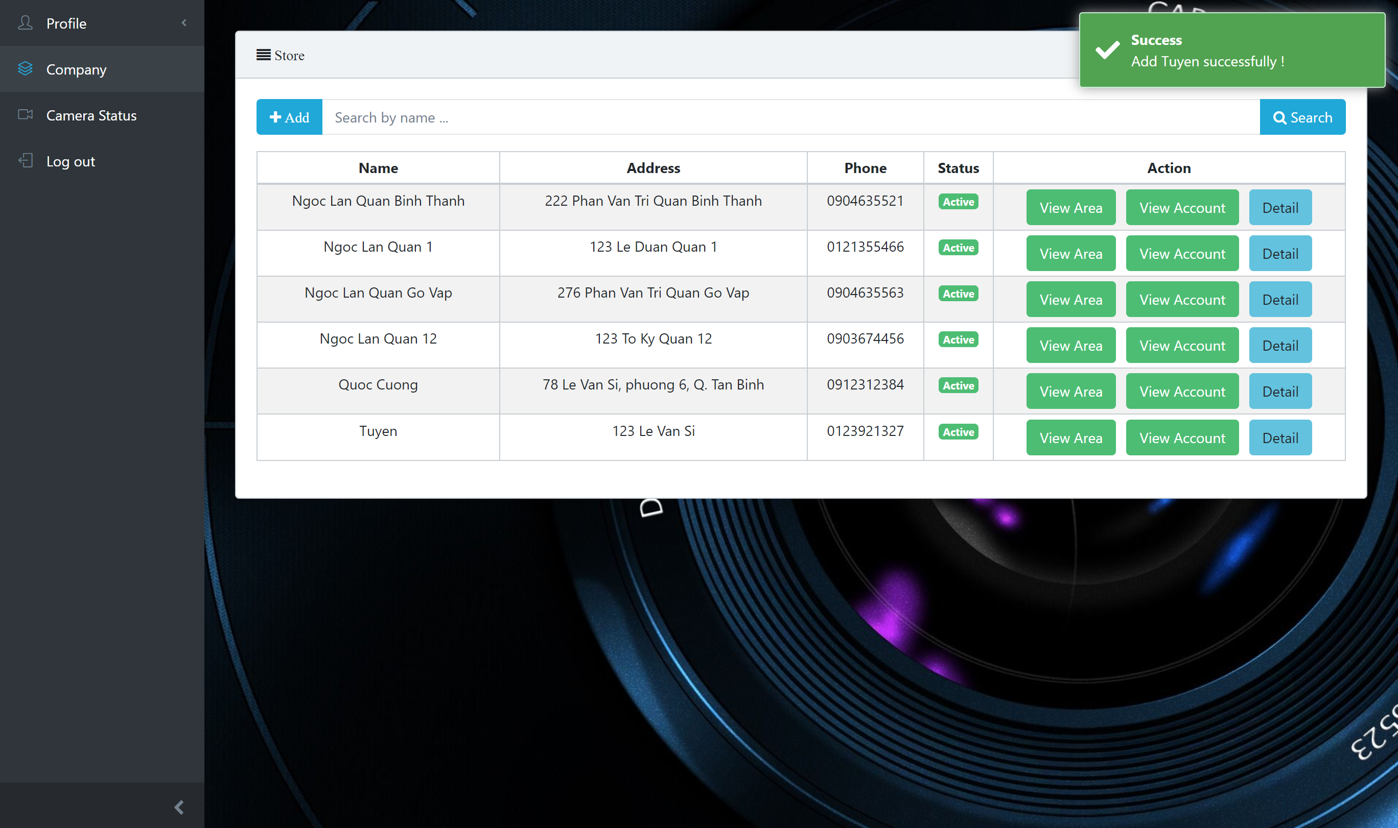
Add one store
2. Click on “View store” button
1. Login into system with admin‘s role
Admin
3. Click on “Add” button
5. Click on “Add” button
4. Fill in require field.
6. System return success and add into company

